Slide 1
Wonderful world of water
Properties of water

Slide 2
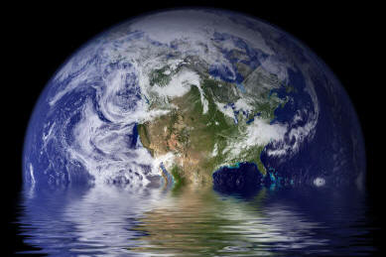
Water in the world
Water makes up 70% of the Earth’s surface
As it turns out, water accounts for 70% of a cell’s mass!
Water helps to maintain homeostasis within a cell/organism.
What are the properties of water that make it so useful to living organisms?

Slide 3
Properties of Water
1. Water is a polar molecule
2. Water is the “universal solvent”
3. Pure water has a neutral pH of 7
4. Water is both adhesive and cohesive
5. Solid water is less dense than liquid water

Slide 4
Properties of Water
1. Water is a polar molecule
2. Water is the “universal solvent”
3. Pure water has a neutral pH of 7
4. Water is both adhesive and cohesive
5. Solid water is less dense than liquid water

Slide 5
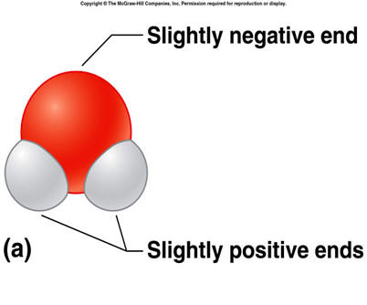
Water is a polar molecule
A water molecule is held together with covalent bonds
Electrons are shared, but they are shared unevenly
A water molecule has an overall positive charge
This makes it great for bonding!
Water molecules form hydrogen bonds easily with other water molecules

Slide 6
Properties of Water
1. Water is a polar molecule
2. Water is the “universal solvent”
3. Pure water has a neutral pH of 7
4. Water is both adhesive and cohesive
5. Solid water is less dense than liquid water

Slide 7
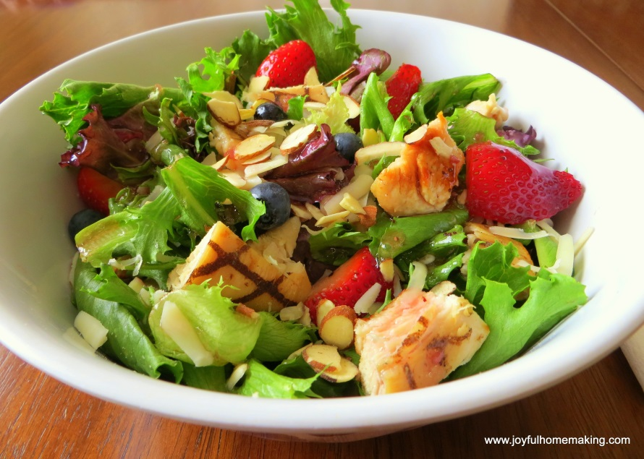
Water is the “universal solvent”
Mixture: a combination of two or more substances in which each substance retains its individual properties
Different from a reaction! No new product is created.
Heterogeneous mixture: components remain distinct
Salads! Sand and water!
Homogeneous mixture: mixture has a uniform composition
Salt water! Iced tea!

Slide 8
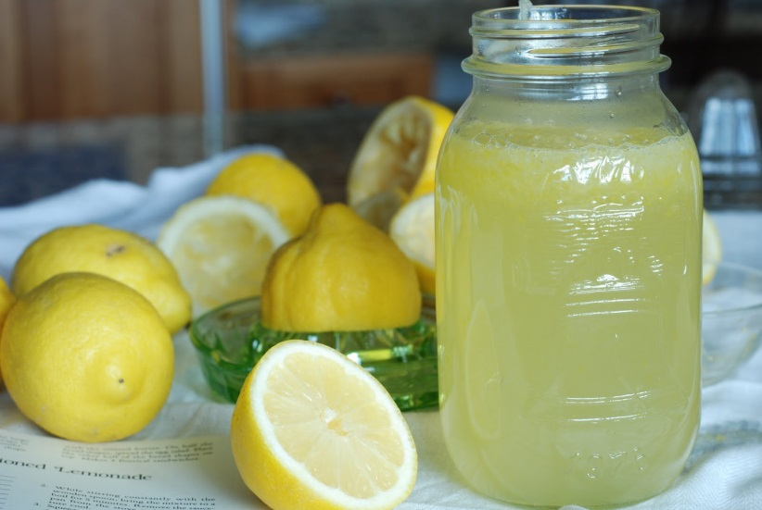
Water is the “universal solvent”
Solvent: the substance that does the dissolving in a mixture.
Solute: the substance that is dissolved in a mixture.
Example – powdered lemonade
Water is the solvent
The lemonade is the solute

Slide 9
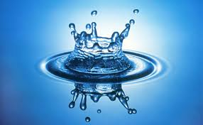
Water is the “universal solvent”
Water is able to dissolve many substances, because it is a polar molecule- making it very useful!

Slide 10
Properties of Water
1. Water is a polar molecule
2. Water is the “universal solvent”
3. Pure water has a neutral pH of 7
4. Water is both adhesive and cohesive
5. Solid water is less dense than liquid water

Slide 11
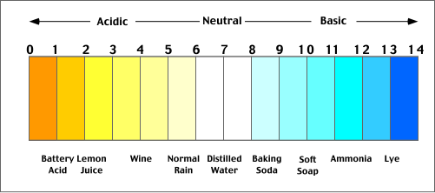
Water has a neutral pH
Acids: substances that release hydrogen ions (H+) when dissolved in water
pH of less than 7
Bases: substance that release hydroxide ions (OH-) when dissolved in water
pH greater than 7

Slide 12
Water has a neutral pH
Pure water has a pH of 7!
Good for carrying out biological processes and allows us to maintain homeostasis

Slide 13
Properties of Water
1. Water is a polar molecule
2. Water is the “universal solvent”
3. Pure water has a neutral pH of 7
4. Water is both adhesive and cohesive
5. Solid water is less dense than liquid water

Slide 14
Water is both adhesive and cohesive
Remember, water is polar and is therefore good for bonding!
Cohesion: water’s ability to form hydrogen bonds with other water molecules (water = water).
Creates a high surface tension
Droplets, bugs and leaves!
Adhesion: water’s ability to form hydrogen bonds with molecules other than water (water = something else).
Capillary action allows plants to draw up water through roots

Slide 15
Properties of Water
1. Water is a polar molecule
2. Water is the “universal solvent”
3. Pure water has a neutral pH of 7
4. Water is both adhesive and cohesive
5. Solid water is less dense than liquid water

Slide 16
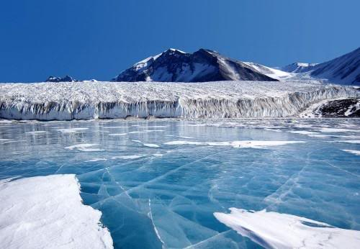
Solid water is less dense
Liquid water becomes less dense as it cools to freezing
Ice is less dense than liquid water
Fish can survive in the winter because ice floats!

Slide 17
pH
The amount of hydrogen ions or hydroxide ions in a solution

Slide 18
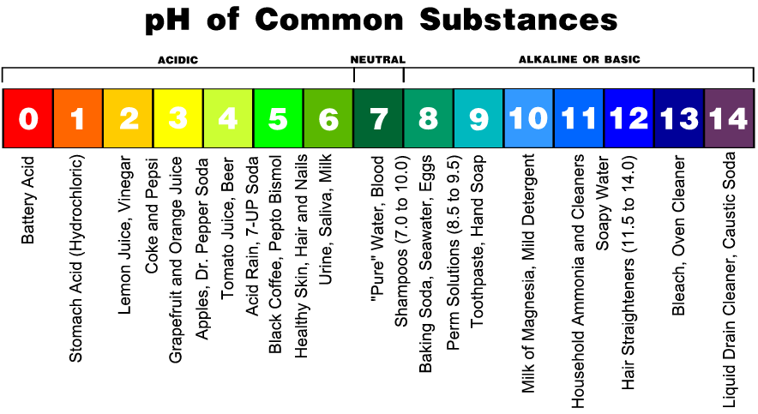
Acids and Bases
Acids
Have an abundance of H+ ions and pH values lower than 7

Slide 19
Acids and Bases
Bases
Have more OH- ions than H+ ions and have pH values higher than 7

Slide 20
Acids and Bases
Most biological processes occur in neutral pH or weak acids/bases
pH range of 6.5 to 7.5
Buffers: react with acids or bases to keep pH within a certain range
Buffers in blood keep pH about 7.4
Antacids help neutralize stomach acid

Slide 21
Macromolecules

