Slide 2
Let’s Review!
Directional Selection
Selection towards a single direction
Disruptive Selection
Selection against the mean (middle)
Selection towards extremes
Stabilizing Selection
Selection towards the mean (middle)
Selection against extreme

Slide 3
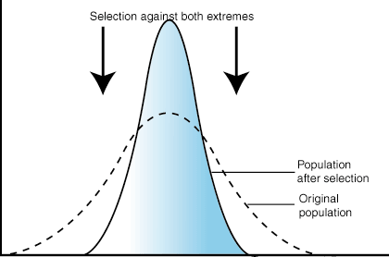
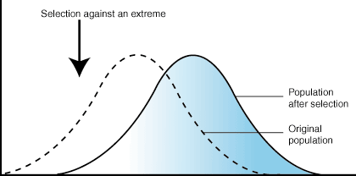
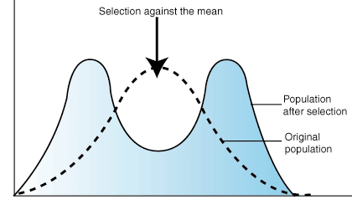
Do you get it?
Directional Selection
Disruptive Selection
Stabilizing Selection

Slide 4
Evolution Scenarios
A. Directional Selection B. Disruptive Selection C. Stabilizing Selection

Slide 5
Evolution Scenarios

Slide 6
Evolution Scenarios
A. Directional Selection B. Disruptive Selection C. Stabilizing Selection

Slide 7
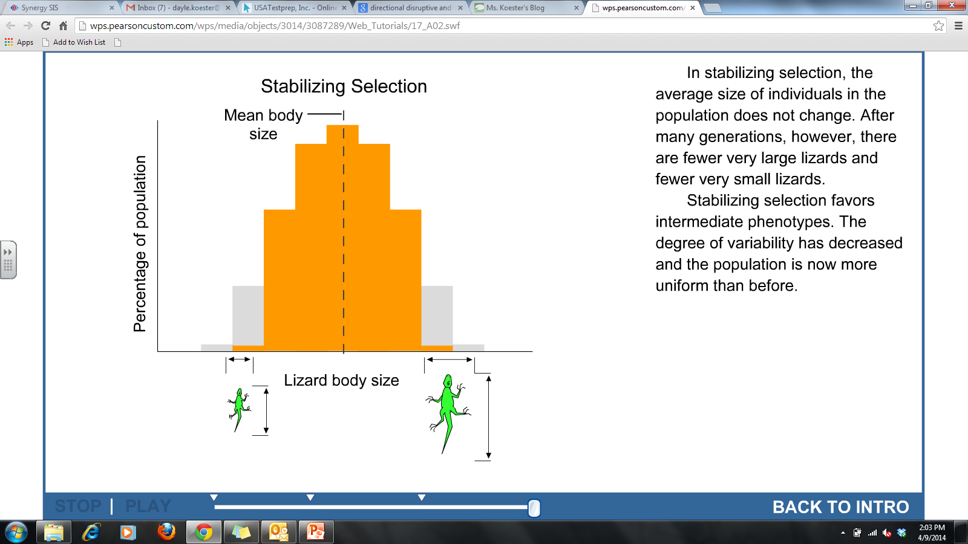
Evolution Scenarios

Slide 8
Evolution Scenarios
A. Directional Selection B. Disruptive Selection C. Stabilizing Selection

Slide 9
Evolution Scenarios

Slide 10
That brings us to speciation…
Speciation: the creation of a new species as a result of evolution.
How do you know when you have a new species?
They can no longer reproduce in their natural settings!

Slide 11
That brings us to speciation…
Rate of Speciation Theories
Gradualism
Evolution occurs slowly and gradually, with very small changes accumulating over a long period of time until a new species develops.
Punctuated Equilibrium
Evolution occurs in short, rapid bursts of change followed by long period of no change.

Slide 12
Do you get it?
A. Gradualism B. Punctuated Equilibrium

Slide 13
Do you get it?
A. Gradualism B. Punctuated Equilibrium

Slide 14
Let’s Switch Gears…Patterns of Evolution
Divergent Evolution
Related species becoming more and more different due to living in different types of environments
Convergent Evolution
Unrelated species becoming similar due to living in similar types of environments
Coevolution
The simultaneous evolution of two species due to their close interaction/relationship

