Slide 1
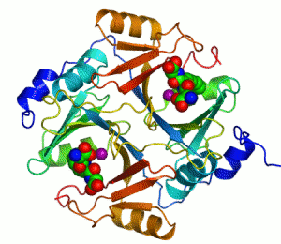
Enzymes

Slide 2
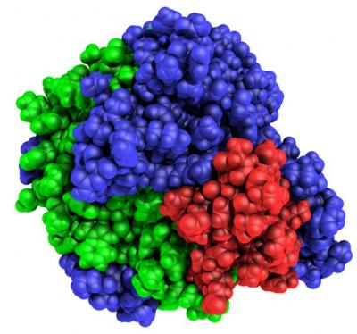
What is an Enzyme?
Most enzymes are proteins
Act as a catalyst to speed up a chemical reaction by helping molecules react with each other faster

Slide 3
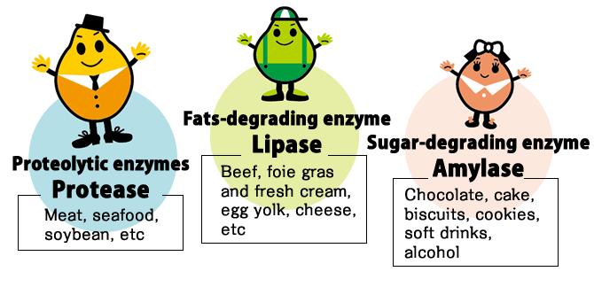
Enzymes are…
Reusable!
Specific for what they catalyze (speed up)
End in “-ase”
Named for the reaction they help. For example…
Sucrase breaks down sucrose
Proteases break down proteins
Lipases break down lipids
DNA polymerase builds DNA

Slide 4
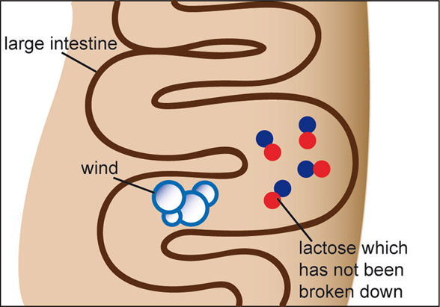
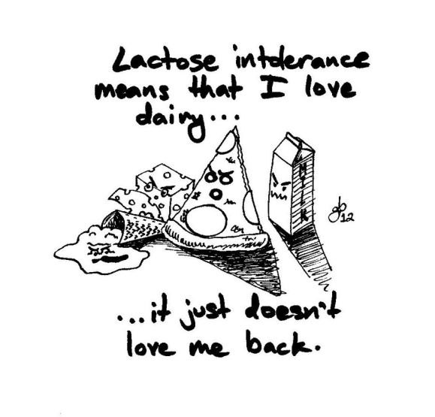
Case Study: Lactose Intolerance
Lactase breaks down lactose, a common component of dairy products (like milk)
People lacking the enzyme lactase are considered “lactose intolerant”-they can’t digest large amounts of milk!!

Slide 5
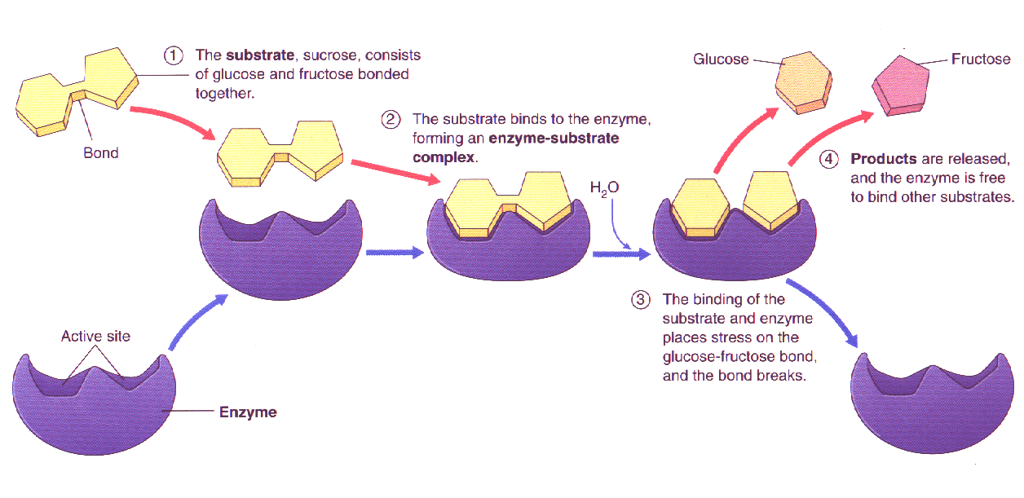
Enzymes are not used up!
Re-used again for the same reaction with other molecules
Very little enzyme is needed to help in many reactions!
Substrate
Active Site
Products
Enzyme

Slide 6
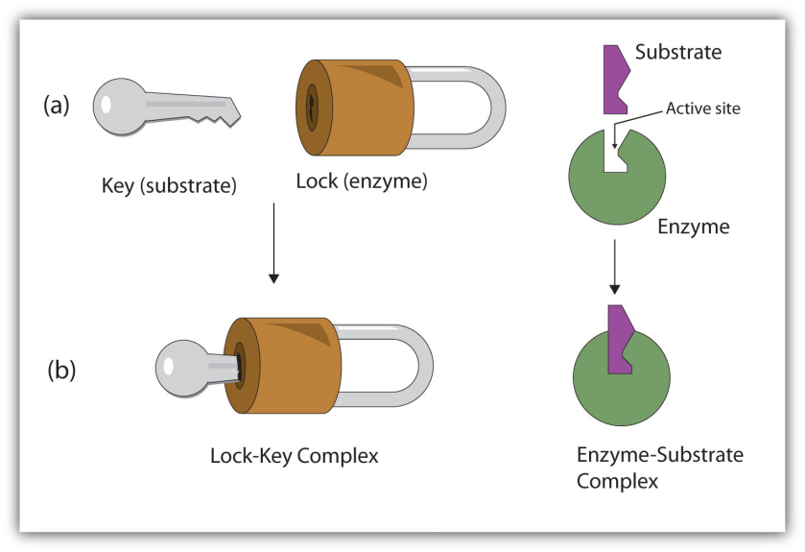
Lock and Key Model
Remember, enzymes are specific!
Lock and Key Model: Shape of enzyme allows substrate to fit
Specific enzyme for each specific reaction
Chemical Reaction
Enzyme + Substrate → Enzyme + Product
REACTANTS PRODUCTS

Slide 7
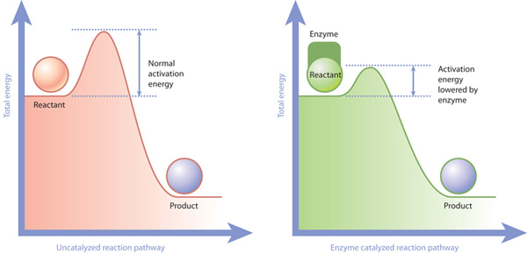
So…How Do Enzymes Work?
Enzymes work by weakening bonds, which lowers ACTIVATION ENERGY
Activation Energy=energy needed for the chemical reaction to occur (energy needed to activate!)
By lowering the activation energy, the reaction can occur faster!
Reactions can occur without the help…but not at the speed our bodies need!

Slide 8
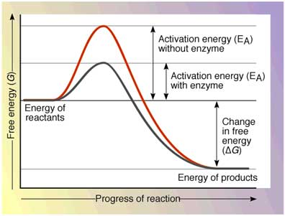

Slide 9
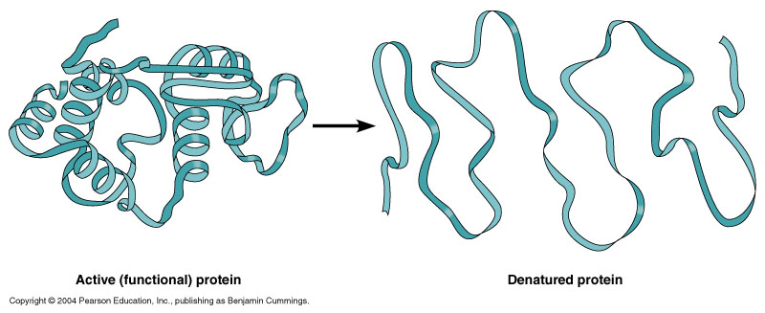
What Effects Enzyme Activity?
Temperature
High temperatures can cause enzymes to denature (unfold and lose shape), while low temperatures slow molecules down
pH
Changes in pH changes protein shape (most human proteins sit at a pH of 6-8)
Denaturing=extreme temperature and pH can change enzyme shape, rendering it useless!

Slide 10
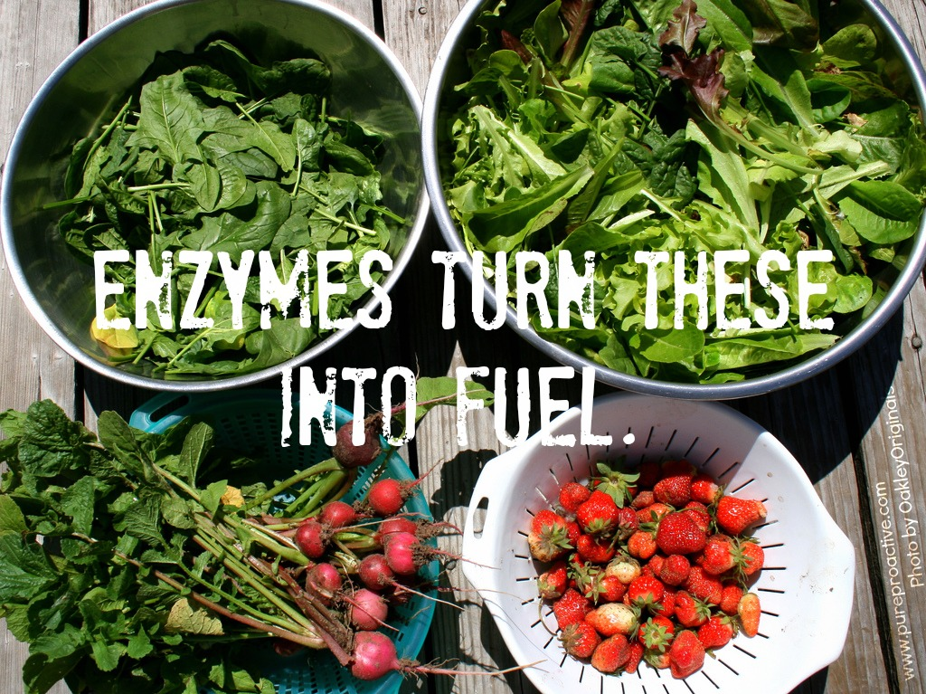
Why are Enzymes Important?
Every reaction in your body is helped by an enzyme. They are necessary for all biological reactions!
https://www.youtube.com/watch?v=XUn64HY5bug

