Slide 1
Unit 10
Ecology
Energy, Cycles, & Human Impact
By: Brandy McClain

Slide 2
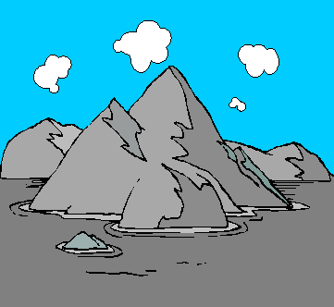
What is ecological succession?
Ecological Succession - The series of changes that occur in a community over time.

Slide 3
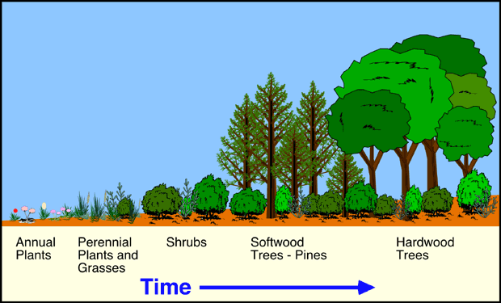
What is ecological succession?

Slide 4
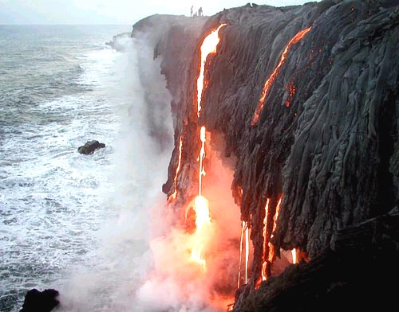
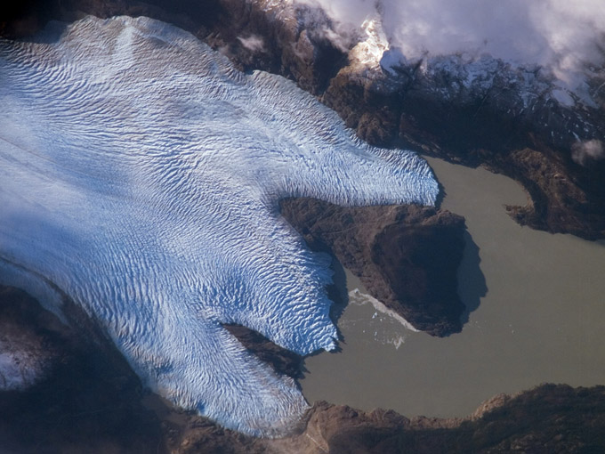
What are the 2 types of
ecological succession?
1st Primary Succession – Occurs when there was no soil for regular plants to grow.
Examples: Volcano eruptions & glaciers retreating

Slide 5
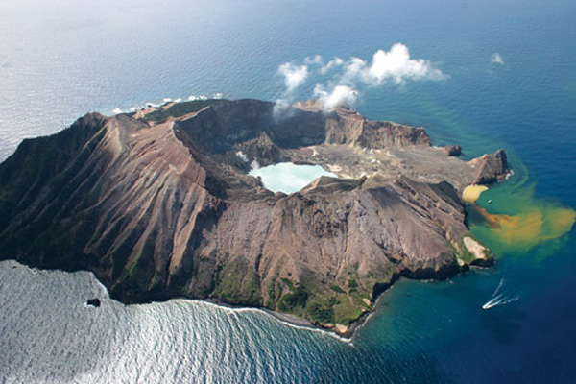
What are the 2 types of
ecological succession?
Volcanoes can create new islands...
No soil is
Available for plants to grow

Slide 6
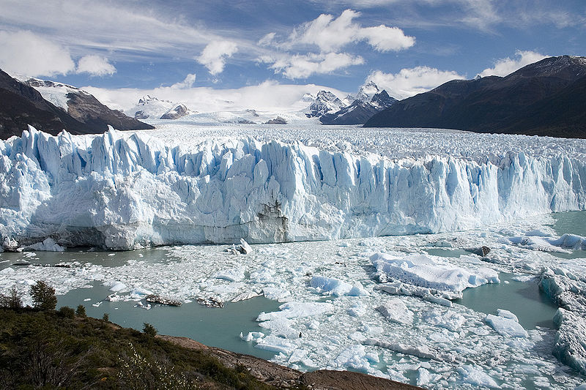
What are the 2 types of
ecological succession?
When glaciers retreat, they leave exposed rock…
No soil for plants to grow in.

Slide 7
How is soil created so plants can grow in the area?
Pioneer Species: A species that will colonize previously uncolonized land. Are organisms that colonize barren rock or lava during ecological succession. They are the FIRST to arrive!
They physically break up the rocks, extract minerals, and provide organic matter that will decompose and become the soil for later successional species.

Slide 8
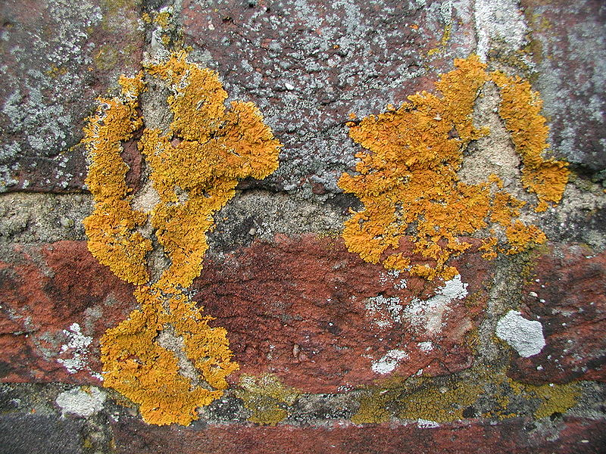
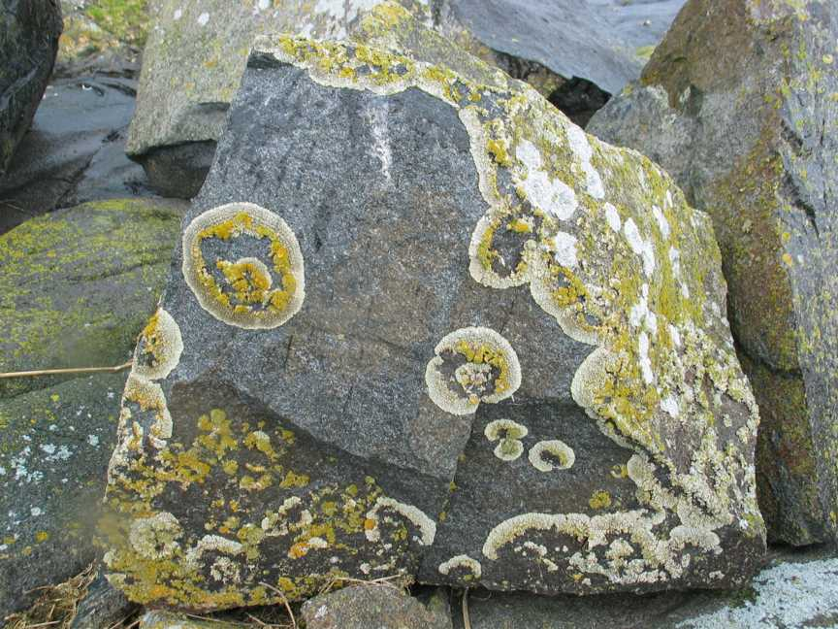
How is soil created so plants can grow in the area?
Example: Lichens
Lichens: A symbiotic relationship between a fungus and an algae.

Slide 9
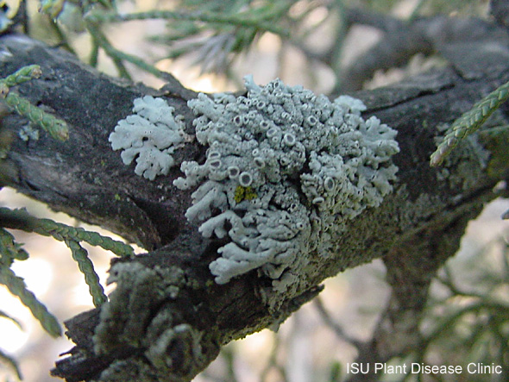
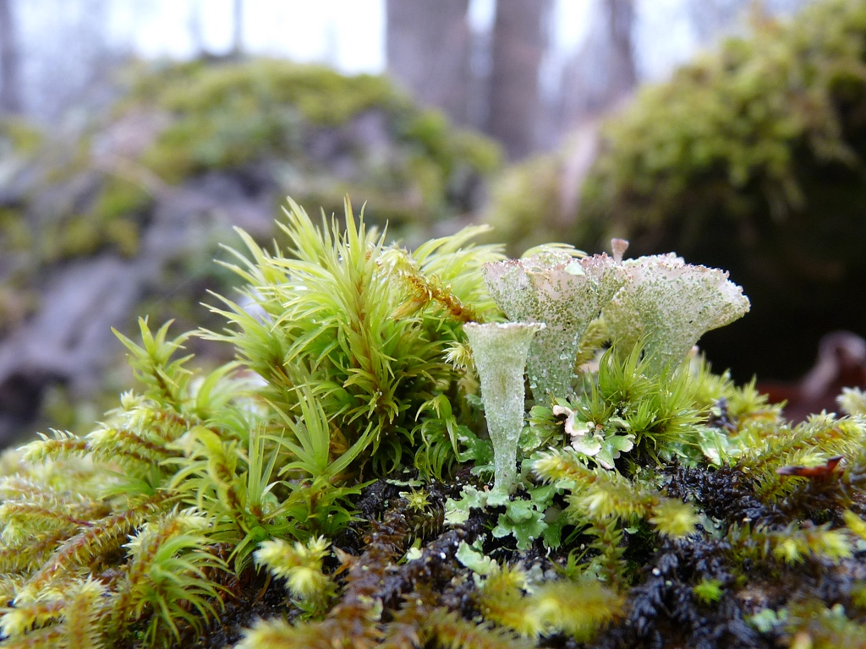
How is soil created so plants can grow in the area?
Lichens help break rocks to form soil so that other plants can grow there later.

Slide 10
Primary Succession Video

Slide 11
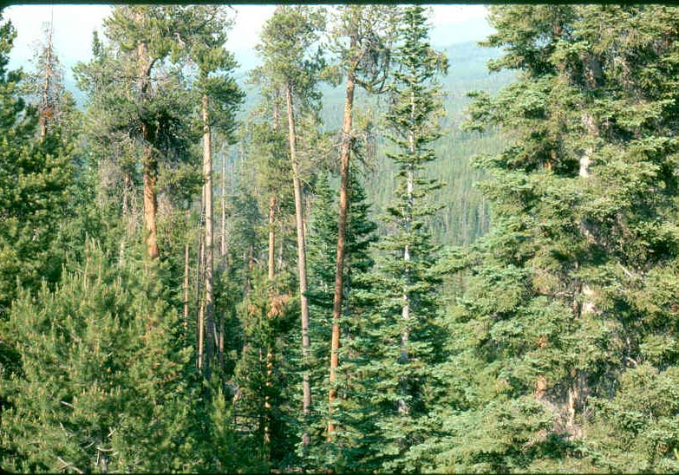
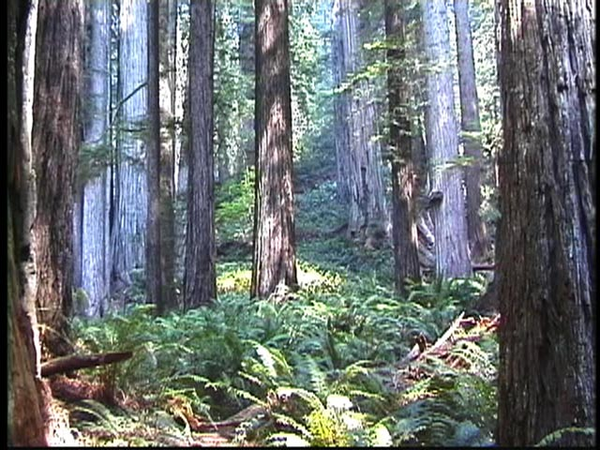
What is a climax community?
Climax Community: Stable, mature ecological community with little change in the composition of species. This is when the community reaches equilibrium, and change very little over time.

Slide 12
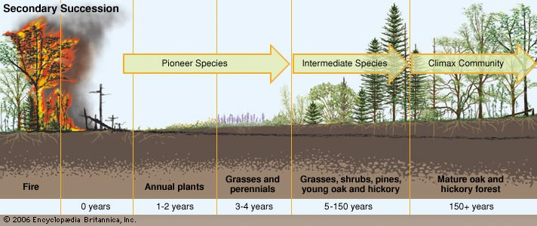
What are the 2 types of ecological succession?
2nd Secondary Succession: Orderly change that occurs in a place soil remains after a community of organisms has been removed.

Slide 13
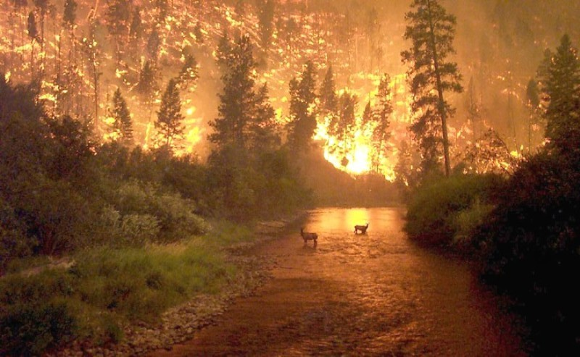
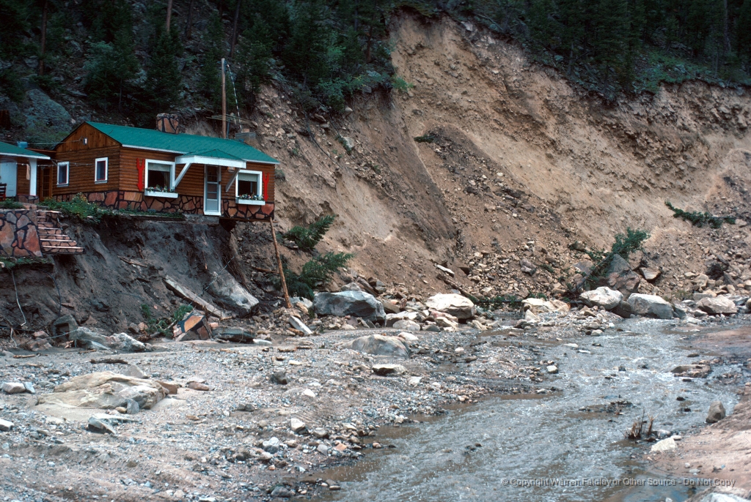
What are the 2 types of ecological succession?
When a disturbance changes a community without removing the soil, secondary succession will follow.

Slide 14
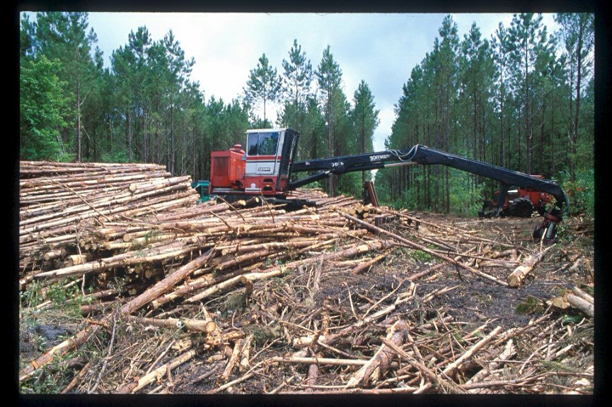
What are some examples of secondary succession?
Examples of Secondary Succession
Forest Fire
Farm land
Flood
Hurricane
Logging
Occurs after a climax community has been destroyed…
soil is already there.

Slide 15
Ecological Succession Video

Slide 16
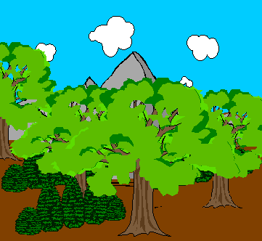
The End

