Slide 1
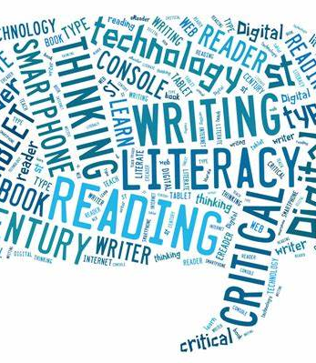
Eagle Literacy March 23rd – 27th
Literacy
Critical
Digital
Financial
Civic
Balanced
Visual

Slide 2
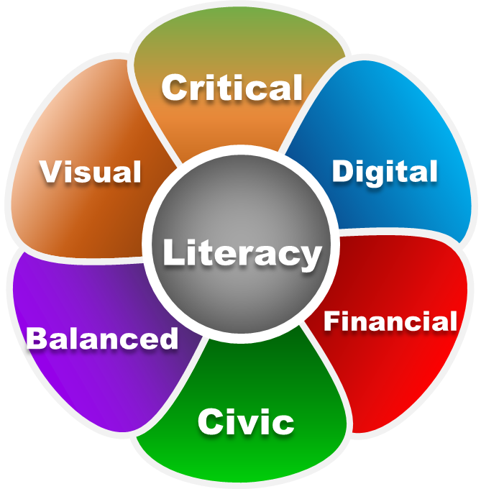
“Digital Literacy”
As we embark on our “new normal”, I wanted students to continue with our literacy novel,
The Sun is Also a Star.
Students can read at different paces so I have created general literacy questions for the chapters.
You can choose how students respond to those discussion questions. Examples may include:
You can have your students read each day or all of the pages for the week. It’s up to you!
Students submit their answers on your blog or discussion forum.
You can have a video conference once a week with your 3rd period to discuss the questions and novel.
Choose which questions you feel would best benefit your 3rd period students.
Remember this is our “new normal” so we can adjust to whatever works best for you and your students.

Slide 3
March 23rd – 26th
“Chapters for the Week” – PDF pages
Monday – pgs. 161-166
Tuesday – pgs. 167-172
Wednesday – pgs. 173-178
Thursday – pgs. 179-182

Slide 4
Monday - Thursday
Novel Questions
*Remember questions are written generically so students can answer regardless of where they are in the novel.
What new character traits do you notice? Do they impact the choices the characters make?
How is the main character changing? What is she/he learning about life and the role they play in society?
What new conflict is presented in the chapters? How do the characters handle the conflict?
What motives our main characters?
What do you predict will happen next?
Notes:
■ stressor (an activity, event, or thing that adds stress)
■ trauma (a deeply distressing or disturbing experience)
■ intergenerational trauma (when untreated trauma gets passed down by parents to their children)
■ race-based trauma (when the experience of a racial encounter impacts someone mentally and emotionally)
■ civil disobedience (the refusal to comply with certain laws or to pay taxes and fines as a peaceful form of political protest)
Discuss how the terms relate to various historical events to reinforce the differences.
■ Slavery, Imperialism/Colonialism: Stressor
■ The Los Angeles Riots after the police beating of Rodney King in 1992: Trauma
■ The Jews who experienced the Holocaust: Intergenerational Trauma
■ The violent colonization and assimilation of Native Americans: Race-based Trauma
■ Martin Luther King’s “Letter from Birmingham Jail” and his other forms of protests: Civil Disobedience

