Slide 1
Eagle Literacy April 20th – 24th

Slide 2
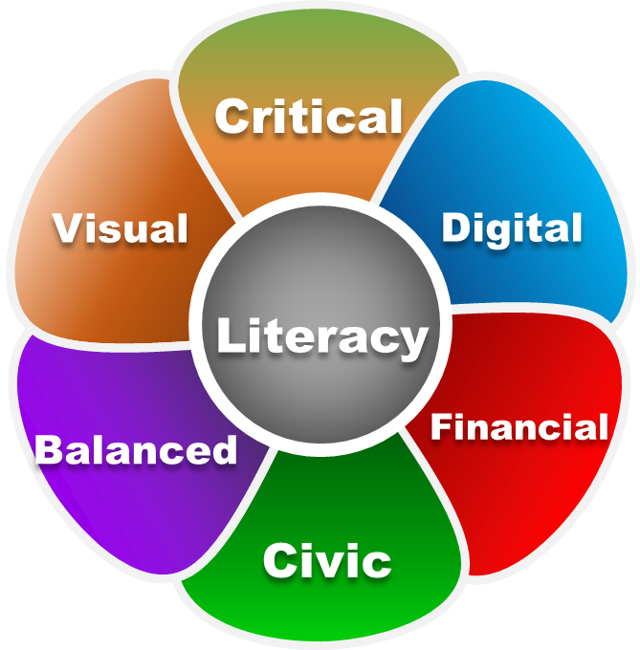
“Digital Literacy”
Students will continue with our literacy novel,
The Sun is Also a Star.
Students can read at different paces so I have created general literacy questions for the chapters.
You can choose how students respond to those discussion questions. Examples may include:
You can have your students read each day or all of the pages for the week. It’s up to you!
Students submit their answers on your blog or discussion forum.
You can have a video conference once a week with your 3rd period to discuss the questions and novel.
Choose which questions you feel would best benefit your 3rd period students.
Remember this is our “new normal” so we can adjust to whatever works best for you and your students.

Slide 3
“Chapters for the Week”
PDF page numbers
Monday – pgs. 226-229
Tuesday – pgs. 230-234
Wednesday – pgs. 235-239
Thursday – pgs. 240-244

Slide 4
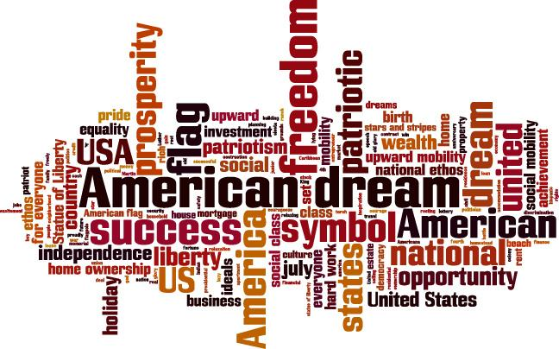
1.The main characters are forced to face the reality of their future and trust minor characters to help their American Dream come to reality. How do the minor characters fulfill their dreams? 2. What unexpected conflict arises? 3. How did America’s promise of a better life provide disappointment and ultimately the prospect of deportation for one character? 4. Analyze the selfishness by minor characters that created a domino effect of events for the main characters. 5. Predict what will occur next.
Novel Questions

