Slide 2


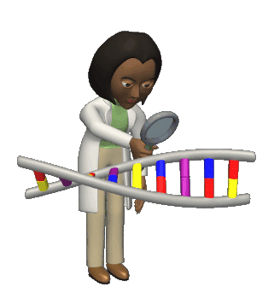
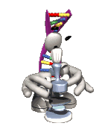
DNA Mutations & Technology

Slide 3
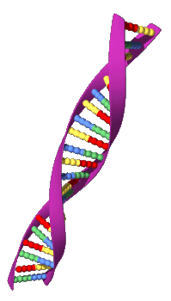
What are genetic mutations?
Mutation: Permanent change in a cell’s DNA, ranging from changes in a single base pair to deletions of large sections of chromosomes.
Causes of mutations include:
* Viruses
* Radiation
* Chemicals
* Errors during mitosis and meiosis

Slide 4
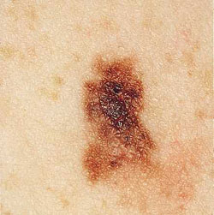
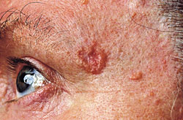
Germ cell mutations
  Occur in sex cells (sperm and eggs)
    Organism itself is not affected, but the offspring is
Somatic mutations
  Take place in the body cells (all cells other than sex cells)
  Organism is affected, offspring is not
    Skin cancer
Basal cell carcinoma
Melanoma

Slide 5
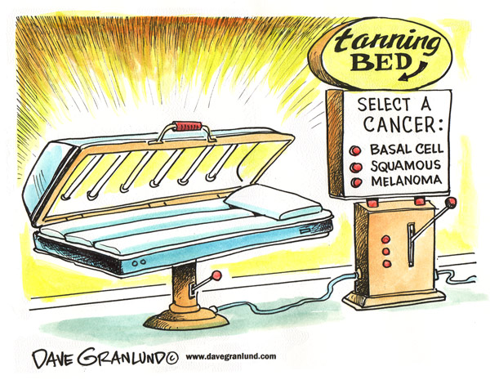
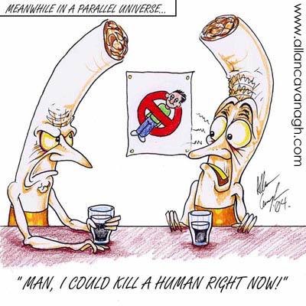
Are mutations harmful?
Some mutations are harmful, some are beneficial, and some do nothing.
Harmful example:
- Some mutations cause cancer & genetic disorders

Slide 6
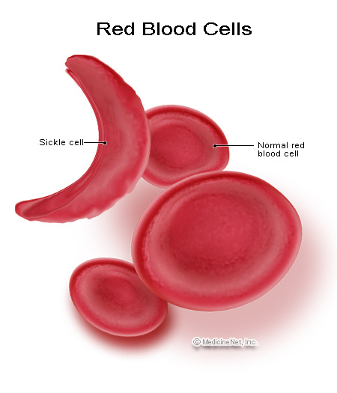
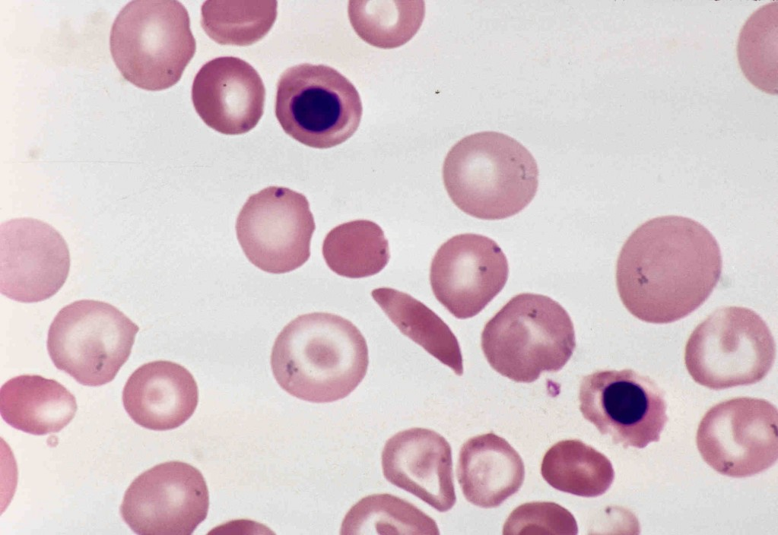
Are mutations harmful?
Helpful example:
- Sickle cell anemia prevents malaria

Slide 7
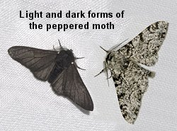
Are mutations harmful?
Not harmful or helpful:
- Peppered moths come in dark or light colors

Slide 8
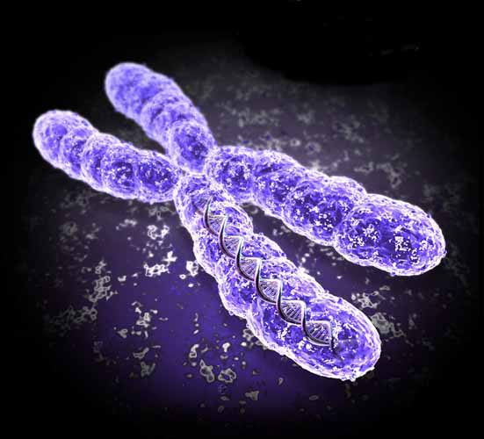
Chromosome mutations often occur during cell division and result in changes in the chromosome structure or loss of entire chromosomes
There are five types

Slide 9
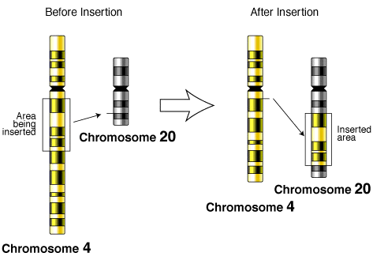
What are some types of mutations?
There are many different types…we will do an activity that demonstrates these mutations:
1. Insertion

Slide 10
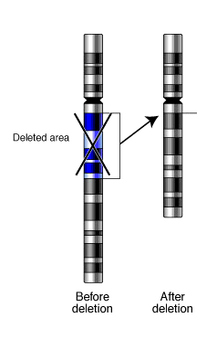
What are some types of mutations?
2. Deletion
A deletion
involves the loss of all
or part of a
chromosome

Slide 11
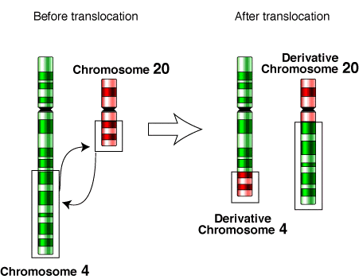
3. Translocation
A translocation occurs when a piece of the chromosome breaks off and attaches to another, non-homologous chromosome

Slide 12
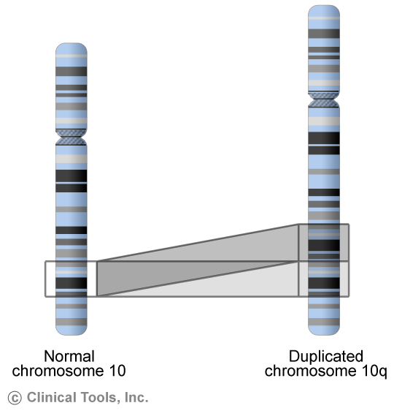
What are some types of mutations?
4. Duplication
When a segment of a chromosome is repeated (opposite of deletion)

Slide 13
Gene mutations involve a single nucleotide within a codon or larger segments of DNA
Mutations that affect a single nucleotide are called point mutations because they occur at a single point in the DNA sequence

Slide 14
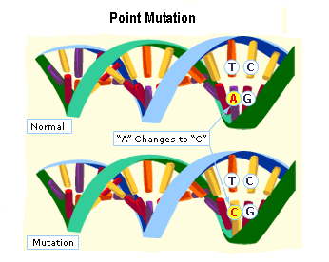
Point Mutation – Substitution
Some point mutations simply substitute one nucleotide for another
  This is a substitution
Most of the time this results in a change in one of the amino acids in a protein
Substitution

Slide 15
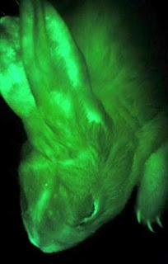
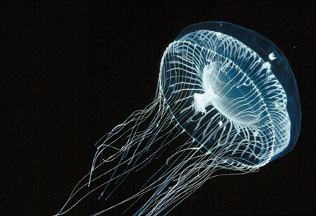
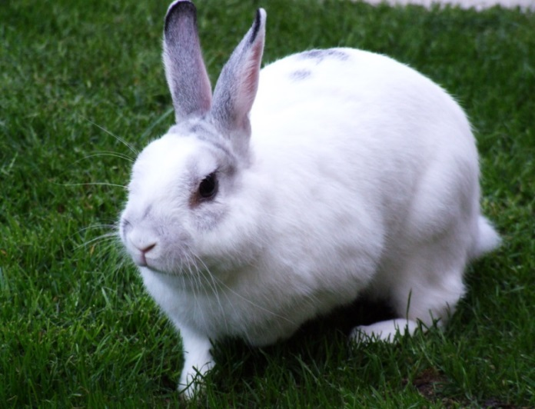
How has technology changed DNA?
Genetic Engineering: Technology used to manipulate an organism’s DNA by inserting the DNA of another organism.
Transgenic Organism: Organism that is genetically engineered by inserting a gene from another organism.

Slide 16
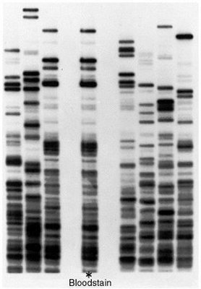
How has technology changed DNA?
Gel Electrophoresis: Process that involves using electric current to separate certain biological molecules by size.
We use this to see DNA fragments to create a DNA fingerprint
  DNA fingerprints have 2 major uses:
    Solve crimes
    Figuring out “who’s the baby’s daddy”

Slide 17
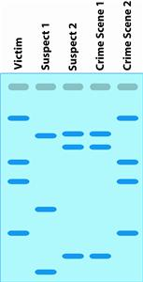
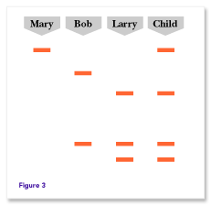
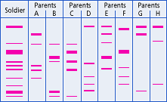
DNA Fingerprinting
Who did it?
Which of the following are his/her parents?

Slide 18
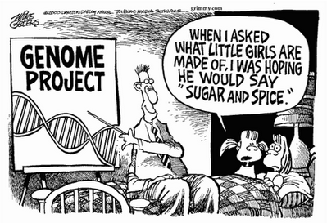
What is the human genome?
Genome: Total DNA in each cell nucleus of an organism
The Human Genome Project:
* Began in 1990 and completed in 2003
* Found that we have 3 BILLION chemical base pairs
* Used to understand genetic disorders and to them

Slide 19
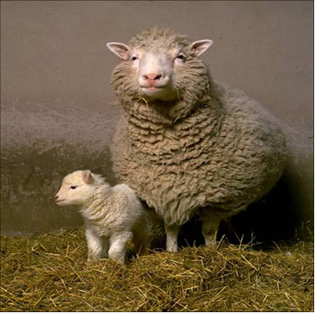
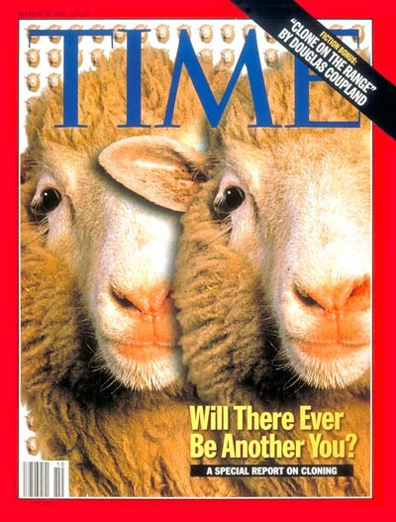
What is cloning?
Cloning: Process in which large numbers of identical recombinant DNA molecules are produced.
“Dolly” the sheep was the first cloned animal

Slide 20
