Slide 1
Energy Flows, Nutrients Cycle
The Water, Nitrogen, Carbon and Phosphorous Cycles

Slide 2
The Cycling of Nutrients
Think about Albert Einstein…..
Now take a deep breath….
Feel smarter yet??

Slide 3
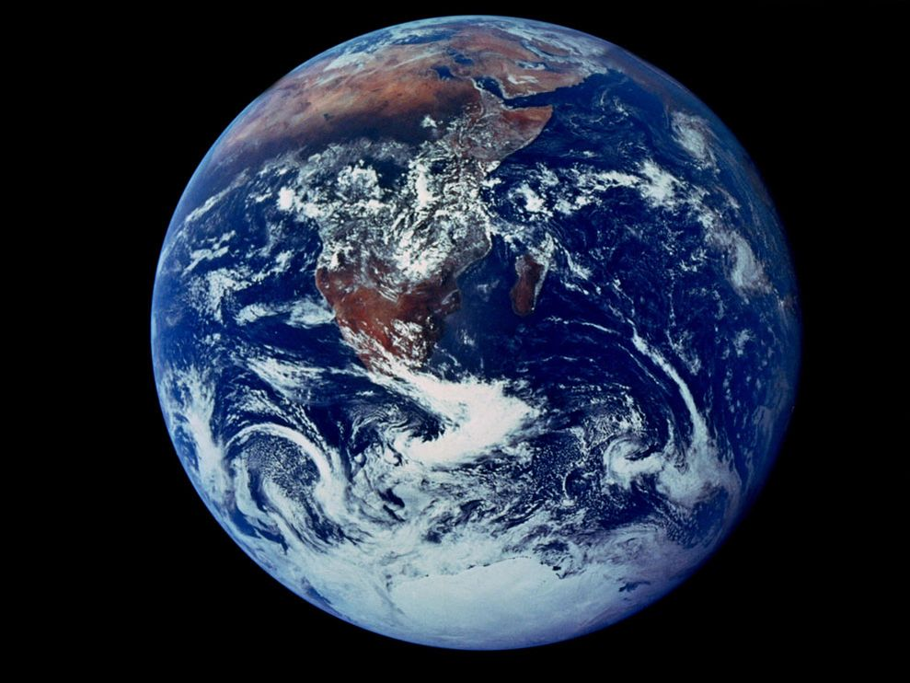
The Cycling of Nutrients
Why must nutrients be cycled?
Simply speaking, a fixed amount of energy and matter exist in the universe.
Matter takes on different forms during different process, but it must continue to go “around and around!”

Slide 4
What’s in it for me?
What are the building blocks of life? CELLS!
What are the building blocks of cells? PROTEINS!
What are the building blocks of proteins? AMINO ACIDS!
What are the building blocks of amino acids?
Carbon, Hydrogen, Oxygen, Nitrogen and Phosphorous!

Slide 5
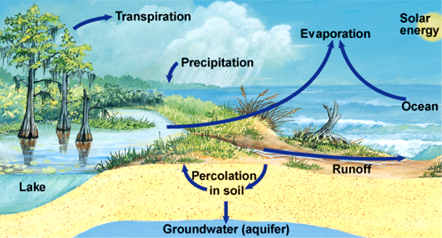
The Water Cycle
Describes the continuous process by which water molecules move from bodies of water, land and living things on earth's surface to the atmosphere and back to Earth's surface
Nearly 70% of the Earth’s surface is covered in water!
Only 1-2% is available as drinking water ☹

Slide 6
The Water Cycle
Evaporation - process by which the surface of a liquid absorbs enough energy to change into a gas (Liquid → Gas)
Transpiration - process by which water is evaporated through a plant's leaves
Condensation - process by which a gas changes to a liquid (Gas → Liquid)
Precipitation - different forms of water that falls back to the Earth's surface
Can be rain, sleet, hail, or snow depending on temperature

Slide 7
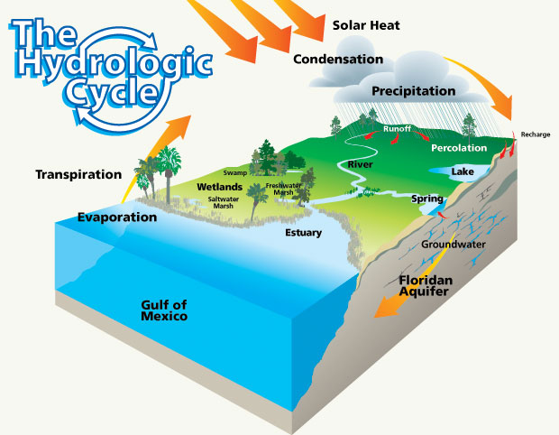
The Water Cycle

Slide 8
The Nitrogen Cycle
The Earth’s atmosphere is made up of ~78% Nitrogen!
Atmospheric Nitrogen (N2), however, is not in a usable form for plants and animals so it must be fixed

Slide 9
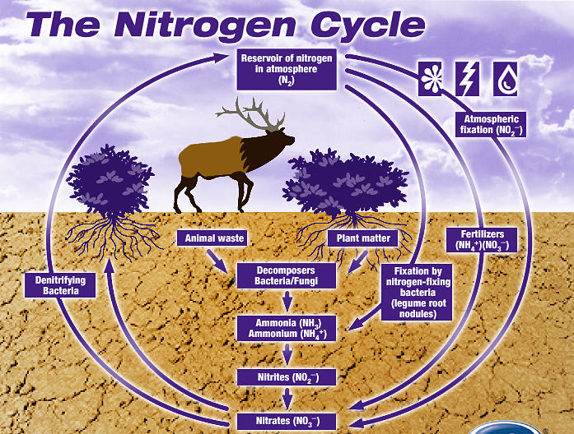
The Nitrogen Cycle
The movement of Nitrogen throughout Earth and the atmosphere
Four main processes
Nitrogen Fixation
Digestion
Decomposition (Denitrification)
Elimination (Wastes)

Slide 10
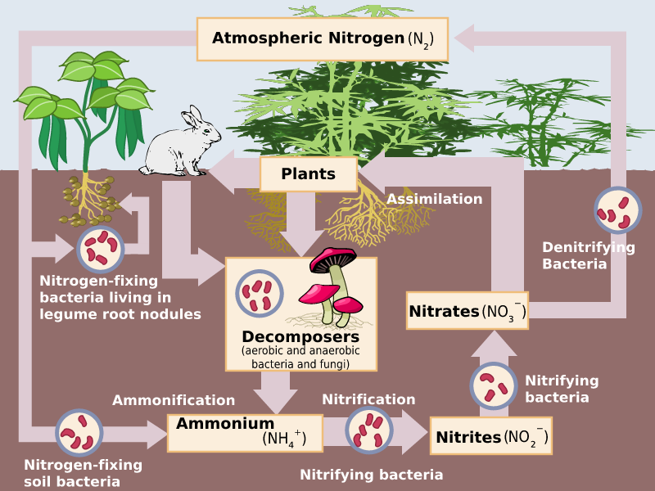
The Nitrogen Cycle
Nitrogen fixation is the process of capturing and converting nitrogen into a form that’s usable by living organisms.
Methods:
Nitrogen Fixing Bacteria
Lightning
Human Factories

Slide 11
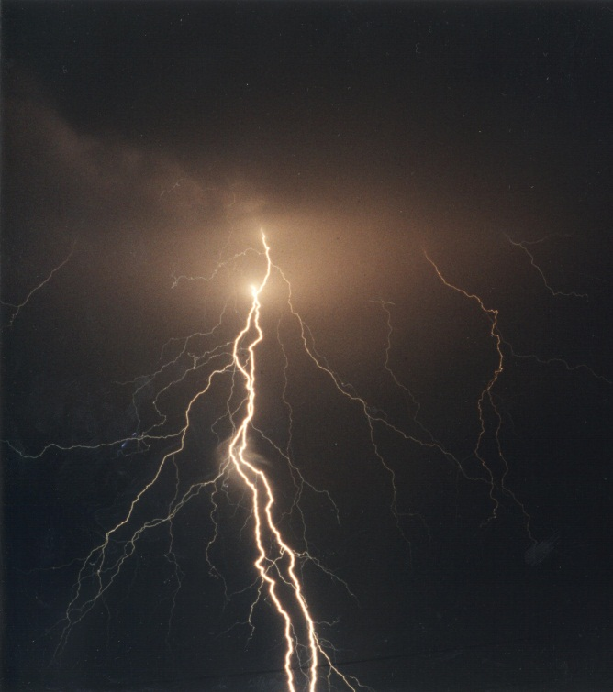
The Nitrogen Cycle
Lightning is very high energy!
The high energy from lightning breaks some nitrogen molecules apart, allowing them to bond with oxygen in the air.
The rain then carries these new compounds down to the soil, where it can be absorbed, used or consumed.

Slide 12
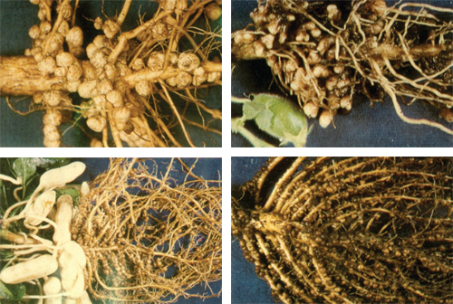
The Nitrogen Cycle
Many nitrogen fixing bacteria exist in symbiotic relationships with plants!
Alfalfa, legumes (Beans, Peas, Corn), clover, soy
Farmers often put these crops into rotation to return nitrogen to the soil
What type of symbiotic relationship is this???

Slide 13
The Nitrogen Cycle
Digestion – Animals eat the plants full of “fixed” nitrogen
Elimination – When animals poop (hehe), the wastes are loaded with nitrogen, returning it to the soil
A fantastic fertilizer!
Decomposition (Denitrification) – the process of breaking down elimination nitrogen and returning the simple nitrogen to the soil and the atmosphere

Slide 14
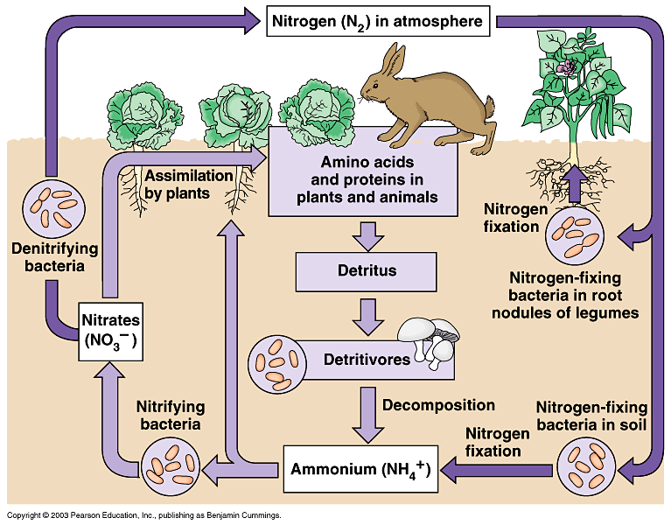
The Nitrogen Cycle

Slide 15
The Carbon Cycle
Let’s review…
What is the purpose of photosynthesis?
Where does it take place?
What is the purpose of cellular respiration?
Where does it take place?

Slide 16
The Carbon Cycle
A complex series of process through which all carbon atoms rotate
Where can you find carbon?
Carbon Dioxide in the atmosphere
Carbonate rock (limestone)
Dead organic matter
Deposits of coal, petroleum and natural gas

Slide 17
The Carbon Cycle
Carbon ENTERS the biotic environment through…
Photosynthesis!
Carbon RETURNS to the atmosphere through…
Respiration, Decomposition and Burning
How are humans impacting the carbon cycle?
Removal of photosynthesizers
Combustion of fossil fuels

Slide 18
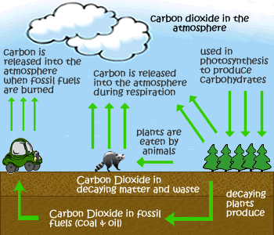
The Carbon Cycle
Carbon is brought in through photosynthesis
Animals and plants return the carbon during respiration
The plants and animal die and can eventually become fossil fuels (gasoline, oil, coal)
Fossil fuels, when burned, return carbon to the atmosphere.

Slide 19
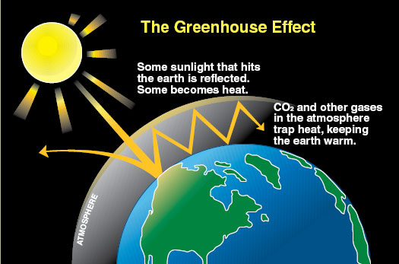
The Carbon Cycle
So what’s the big deal with burning fossil fuels?
Delicate balance of gases is necessary
Humans are putting TOO MUCH carbon back into the atmosphere, causing an increase in trapped heat (greenhouse effect).
Can possibly lead to global warming

Slide 20
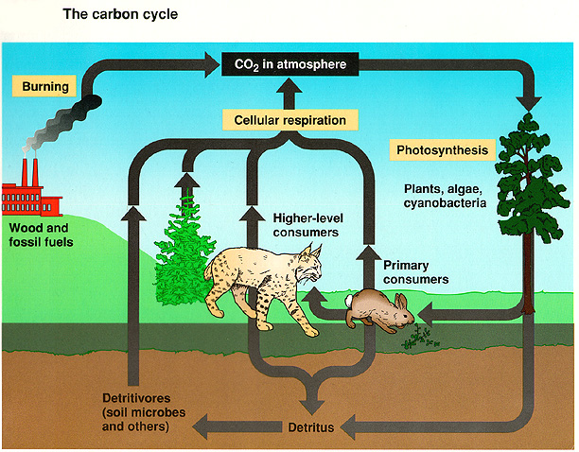
The Carbon Cycle

Slide 21
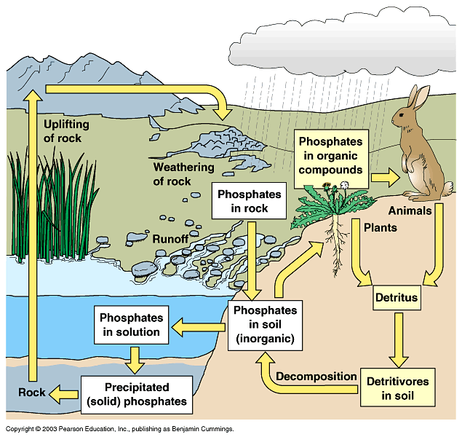
Phosphorus Cycle
Most similar to the Nitrogen Cycle
A sedimentary cycle by which phosphate goes from organic to inorganic.
Phosphorus is an essential nutrient for animals and plants.
It is a key component in ATP, DNA, and lipids

Slide 22
Phosphorus Cycle
Over time, rain and weathering cause rocks to release inorganic phosphate.
The inorganic phosphate is distributed in the soil and water.
Plants take up the inorganic phosphate from the soil.
The plants are consumed by animals giving them the phosphate.

Slide 23
Phosphorus Cycle
When a plant or animal dies, they decay and organic phosphate is returned to the soil
Bacteria break down the organic phosphate into inorganic phosphate in the soil
Phosphorus in the soil can end up back in the water

Slide 24
Phosphorus Cycle

