Slide 1
The Dynamic earth
Section 2: The Atmosphere
Standards: SEV1a, SEV1e

Slide 2
What is the atmosphere?
Mixture of gases that surround the Earth.

Slide 3
What is the composition of the atmosphere?
78% nitrogen
From volcanoes, decaying organisms
21% oxygen
From plants
1% various gases: argon, CO2, methane, water vapor
Particulates
From soil, salt, fire ash, pollen, bacteria, aerosols (tiny, liquid droplets)

Slide 4
What are the layers of the atmosphere?
Troposphere
Closest to earth
Densest layer
Where weather occurs
Temperature decreases as you reach upper levels
Stratosphere
Where ozone layer found
Temperature increases as you reach upper levels
Ozone layer decreases UV radiation that reaches Earth’s surface
Mesosphere
Coldest layer
Thermosphere
Outermost layer
Hottest layer but doesn’t feel hot due to lack of heat transfer between air particles

Slide 5
Why is the atmosphere important?
Helps control temperature of planet.
Without gases in atmosphere it would be too cold to live here.

Slide 6
What is “Earth’s Energy Budget”?
Solar energy reaches earth as visible light, infrared radiation, and UV light.
About 50% reaches surface of Earth and is absorbed by land and ocean.
25% scattered & reflected by clouds
20% absorbed by ozone, clouds, gases
5% reflected by Earth’s surface (light colored)

Slide 7
How does the atmosphere help control the temperature of Earth?
After Earth’s radiation strikes surface of Earth it re-radiates and is trapped by greenhouse gases in atmosphere.
Greenhouse gases include: CO2, methane, water vapor, nitrous oxide
Greenhouse effect is VITAL- without it planet would be too cold!
TOO MUCH greenhouse gas CAN be bad- planet can get too hot.

Slide 8
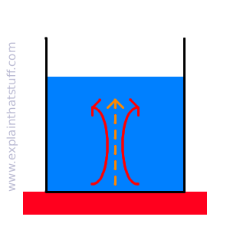
How are wind patterns created?
Caused by uneven heating of earth’s atmosphere which creates convection currents.
Convection currents- air heats up and rises; air cools and sinks; repeat

Slide 9
Why are cities usually hotter than rural areas?
Urban Heat Island Effect
Cities have darker surfaces and fewer plants so therefore store more heat and have higher temperatures than rural areas.
How can this problem be mitigated (fixed)? Watch video and write down some ideas…
Heat Island Video Segments from EPA
Heat & Health Clip= 2:05 min
Mitigation= 2:06 min

