Slide 1
The Dynamic Earth
Section 1: The Geosphere
Standards: SEV1a, SEV1e

Slide 2
Why is the Earth classified as a “system”?
A system consists of parts that work together.
Parts of the Earth:
Geosphere/lithosphere
Atmosphere
Hydrosphere
Biosphere

Slide 3
What makes up the Geosphere?
All the rocks and soil on Earth’s surface.
Scientists divide the geosphere into
COMPOSITIONAL layers
PHYSICAL layers.
1 kilometer= 0.62 mile or 10 football fields.
Notes:
Compositional layers are on the right and physical layers are on the left.

Slide 4
What are the COMPOSITIONAL layers of the Geosphere?
Density, temperature & pressure increase as you go towards center.
Crust
Thin, outer layer (5-70 km thick)
Lightweight elements
Less than 1% of Earth’s mass
Thicker beneath continents and thinner under ocean.
Mantle
Thicker middle layer (2,900 km thick)
Dense, iron-rich material
Core
Inner sphere (3,400 km radius)
Sphere of hot, dense nickel and iron

Slide 5
What are the PHYSICAL layers of the Geosphere?
Lithosphere
Crust and uppermost mantle
Consists of tectonic plates
Asthenosphere
Mantle rock that moves slowly. Solid yet plastic
Allows tectonic plates to move
Mesosphere
Lowest part of mantle
Outer core
Liquid nickel and iron
Inner core
Solid nickel and iron
4,000-5,000ºC
Enormous pressure
Notes:
Plasticity is somewhere between a semi-solid and a liquid.

Slide 6
How are the layers of Earth determined?
Scientists use seismic waves to “see” and learn about Earth’s interior.
Seismic waves react differently when they hit or pass thru a material.

Slide 7
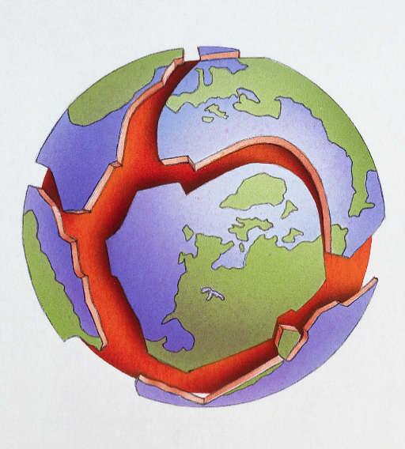
Plate tectonics
Tectonic plates glide on asthenosphere
Major plates:
Pacific, N. American, S. American, African, Eurasian, Antarctic
Geologic activity occurs along plate boundaries
Divergent- pull apart- get volcano or ridge
EX: Mid-Atlantic ridge where N. American plate and Eurasian plate moving in opposite directions.
Convergent- push together- get mountain
EX: Himalayans when Indian plate hit Eurasian plate
Transform- plates rub against each other- get earthquake
EX: Where N. American plate rubs against Pacific plate get earthquakes in CA.

Slide 8
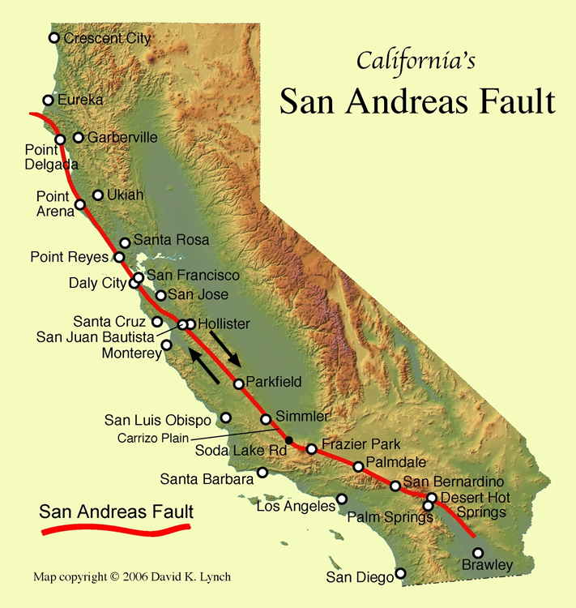
Earthquakes
Vibrations in Earth’s crust caused by sudden stress break along a fault.
If it happens under water it can cause tsunami.
EX: Indonesian tsunami in 2004
Earthquake and tsunami animation

Slide 9
Earthquakes
Richter scale- used to quantify amount of energy (magnitude) released by quake.
2.0 magnitude is smallest
9.5 is greatest recorded (Chile in 1960)
Difference between 1 whole number and another on the scale is 31.7
EX: Magnitude 6.0 is 31.7 times greater than 5.0.
Quakes of 7.0 or greater cause widespread damage
Daily Earthquake Data

Slide 10
Earthquakes
Hazards
Can’t predict when will happen
Damage depends on type of soil
Sandy soil = more damage
Buildings built to be flexible so can sway with vibrations.

Slide 11
Comparison of Haiti & Chile 2010 Earthquakes
Haiti
Magnitude 7
8 miles below surface
Right outside Port-Au-Prince
220,000 people killed
Buildings leveled b/c not built to earthquake code- have no codes- poorer country
People not educated about how to react
Last major earthquake in Port-Au-Prince was 250 years ago.
Chile
Magnitude 8.8
21 miles below surface
200 miles outside city
100’s killed
Buildings built to earthquake code so not leveled- wealthier country
People are educated
Has experienced many earthquakes

Slide 12
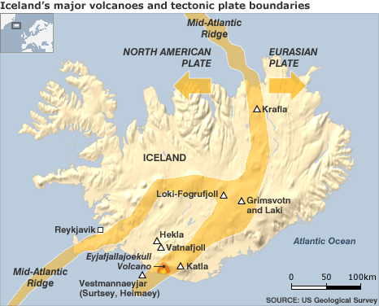
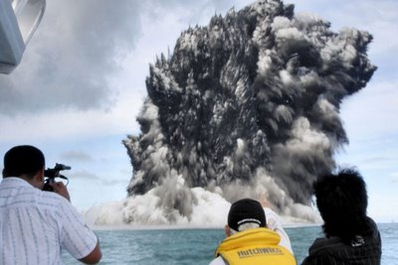
Volcanoes
Volcano formation
Mountain build from magma that rises from the Earth’s interior to the surface.
Where plate diverges or converges
On land or under ocean
High pressure- eruption causes magma, ash, gases to burst from volcano
Low pressure- magma leaks out slowly
Massive volcanic explosion underwater near Tong Islands in South Pacific
Notes:
Eyjafjallajokull eruption in Iceland back in 2010 disrupted air travel b/c of all the ash and smoke that was spewing into atmosphere. This volcano is forming under the ocean and has built up so much now that it has breached the surface of the ocean and is now forming a new island near Iceland. This is a good example of two plates pulling apart, magma comes to surface, hardens, forms land (ridge).

Slide 13
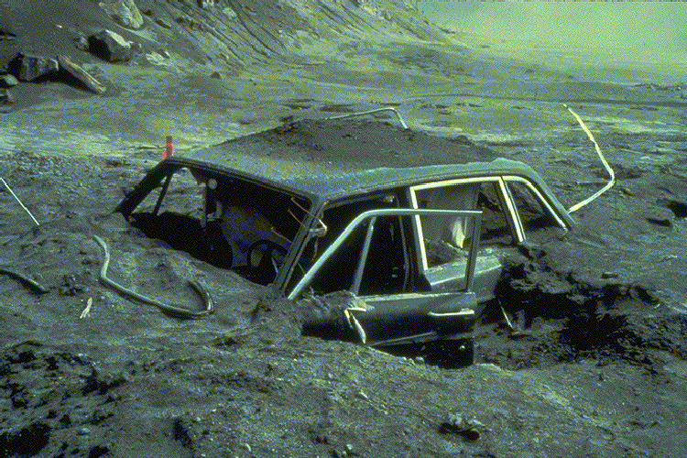
Volcanoes
Local Effects
Local economies affected
Human loss
Ash, dust, gases (sulfur)
Can create mudflow
Bury homes, crops
Respiratory illness
Global Effects
Climate changes
Sulfur particles reflect light, cool temperature
Ash blocks sunlight- snowed in New England in July b/c of 1815 Mt. Tambora volcano in Indonesia
Acid rain

Slide 14
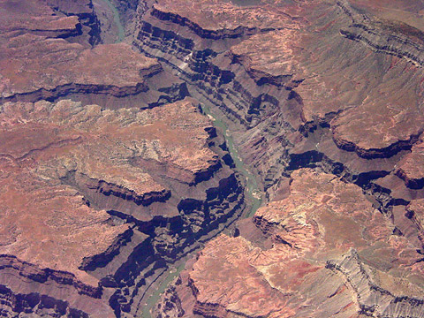
Erosion
Removal and transport of surface material like rocks and soil
Older a mountain range the more rounded, weathered it is
EX: Appalachian Mtns are older than Rockies
Caused by
Water
Wind

