Slide 1
Science & the Environment
Section 1: Understanding our Environment
Standards: SEV4a, SEV5d, SEV5e

Slide 2
What is Environmental Science?
The study of the impact of humans on the environment.

Slide 3
What are the goals of environmental science?
To understand and solve environmental problems.
2 Main Types of Interactions btwn Humans & Env.
How we use natural resources
How our actions alter the environment

Slide 4
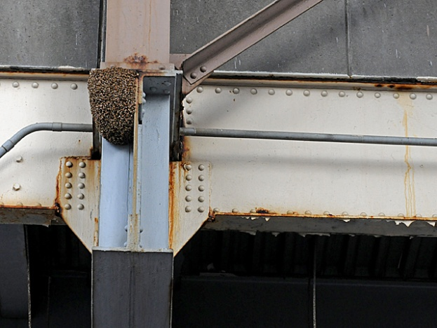
How is Env. Science different from Ecology?
Ecology- study of interactions of living things with each other & their non-living environment
Env. Science- includes how HUMANS impact living & non-living things.

Slide 5
Why is Env. Sci. called an Integrated Science?
Branch of Science | Description- study of…
Zoology | animals
Botany | plants
Microbiology | Microorganisms like bacteria
Geology | Earth’s surface, interior, soil, history
Paleontology | Fossils
Climatology | Earth’s atmosphere and climate
Hydrology | water
Engineering | Matter & energy are made useful to humans in structures, machines, & products
Geochemistry | Chemistry of rocks, soil, & water
Sociology | Study of human populations
Many fields of study:

Slide 6
Why is env. Science often called a “Citizen science”?
Most environmental problems are first discovered & studied by citizens in a community.
Citizens then alert scientists to a problem that needs to be studied.

Slide 7
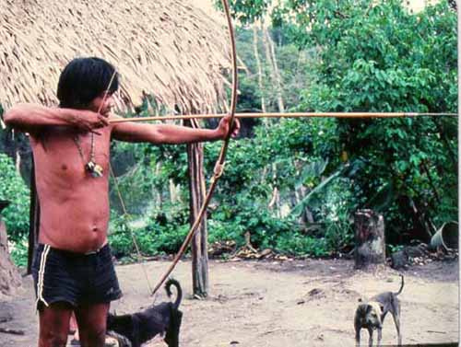
History of environmental science
Hunters-gatherers
Nomadic- small, migrating group
Collect plants, hunt animals, scavengers
Still around in remote regions of the world
Major env. Impact- overhunting of large mammals

Slide 8
History of environmental science
Agricultural Revolution
Began c.10,000 years ago
Began domesticating animals & saving, planting seeds
Animals plowed field
Population grew
need help on farms
consistent food source to support more people
Habitats destroyed to make way for farm land
Poor farming techniques destroyed land

Slide 9
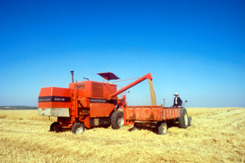
History of environmental science
Industrial Revolution
Mid-1700’s
Introduction of fossil fuels & machinery
Reduced need for large families b/c machines did all work
People began migrating to cities for factory work.
Improved technology= new medicine, sanitation, nutrition
Most environmental problems started during this time.

Slide 10
History of environmental science
Overpopulation
Caused by agricultural & industrial revolution
Puts large strain on
Natural resources
Biodiversity

Slide 11
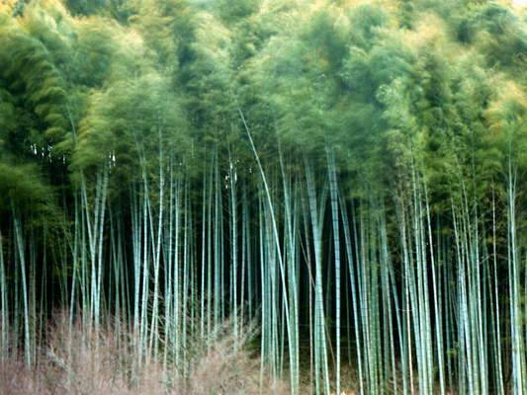
What are our three main environmental problems?
Resource depletion
Natural resources are either…
Renewable- can be replaced quickly by natural processes
Ex: air, trees, crops
Non-renewable- cannot be replaced quickly
Ex: minerals & fossil fuels
Both can become depleted if harvested faster than can be replaced.

Slide 12
What are our three main environmental problems?
Pollution
Negative change in air, water, or soil that affects health or survival of living things
Two types:
Biodegradable- can be broken down
Ex: sewage, food
Non-biodegradable- cannot be broken down by natural processes
Ex: lead, mercury, plastic

Slide 13
What are three main environmental problems?
Loss of Biodiversity
Biodiversity- number & variety of species that live in an area.
Most current extinctions are due to HIPPO
Habitat loss
Introduced species
Pollution
Population growth (humans)
Overharvesting

