Slide 1
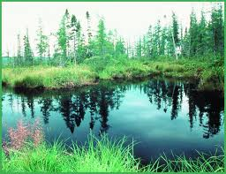
Freshwater Ecosystems
The types of organisms in an aquatic ecosystem are mainly determined by the water’s salinity.
As a result, aquatic ecosystems are divided into freshwater and marine ecosystems.
Freshwater ecosystems include ponds, lakes, streams, rivers, and wetlands.
Wetlands are areas of land that are periodically under water or whose soil contains a great deal of moisture.

Slide 2
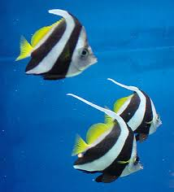
Characteristics of Aquatic Ecosystems
Factors such as temperature, sunlight, oxygen, and nutrients determine which organisms live in which area of the water.
Aquatic ecosystems contains several types of organisms that are grouped by their location and by their adaptation.
Three groups of aquatic organisms include plankton, nekton, and benthos.

Slide 3
Characteristics of Aquatic Ecosystems
Plankton are the mass of mostly microscopic organisms that float or drift freely in the water, and can be microscopic animals called zooplankton or microscopic plants called phytoplankton.
Nekton are all organisms that swim actively in open water, independent of currents.
Benthos are bottom-dwelling organisms of the sea or ocean and are often attached to hard surfaces.
Decomposers are also aquatic organisms.

Slide 4
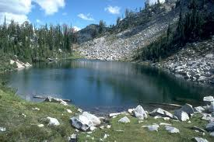
Lakes and Ponds
Lakes, ponds, and wetlands can form naturally where groundwater reaches the Earth’s surface.
Humans intentionally create artificial lakes by damming flowing rivers and streams to use them for power, irrigation, water storage, and recreation.
Lakes and ponds can be structured into horizontal and vertical zones.
The types of organisms present depend on the amount of sunlight available.

Slide 5
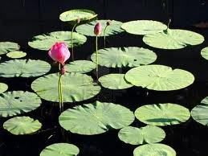
Life in a Lake
The littoral zone is a shallow zone in a freshwater habitat where light reaches the bottom and nurtures plants and aquatic life is diverse and abundant.
Some plants are rooted in the mud underwater with their upper leaves and stems above water.
Other plants have floating leaves.
In open water, plants, algae, and some bacteria capture solar energy to make their own food during photosynthesis.

Slide 6
Life in a Lake
Some bodies of fresh water have areas so deep that there is too little light for photosynthesis.
Bacteria live in the deep areas of freshwater. Fish adapted to cooler, darker water also live there.
Eventually, dead and decaying organisms reach the benthic zone.
The benthic zone is the region near the bottom of a pond, lake or ocean which is inhabited by decomposers, insect larvae, and clams.

Slide 7
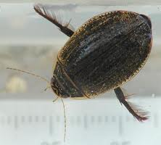
Life in a Lake
Animals that live in lakes and ponds have adaptations that help them obtain what they need to survive.
For example, water beetles use the hairs under their bodies to trap surface air so that they can breathe during their dives for food.
And, in regions where lakes partially freeze in the winter, amphibians burrow into the littoral mud to avoid freezing temperatures.

Slide 8
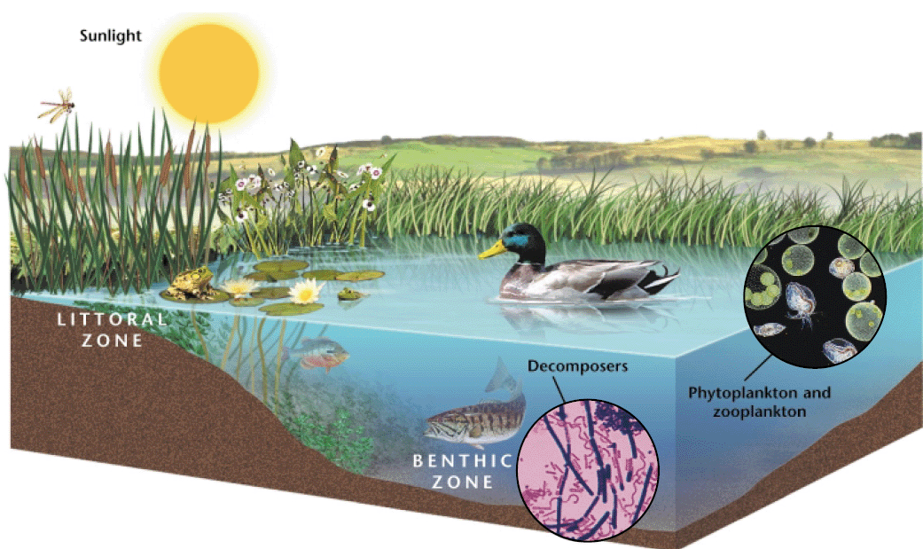
A Lake Ecosystem

Slide 9
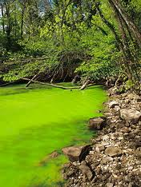
How Nutrients Affect Lakes
Eutrophication is an increase in the amount of nutrients, such as nitrates, in an aquatic ecosystem.
As the amount of plants and algae grow, the number of bacteria feeding on the decaying organisms also grows.
These bacteria use the oxygen dissolved in the lake’s waters.
Eventually the reduced amount of oxygen kills oxygen loving organisms

Slide 10
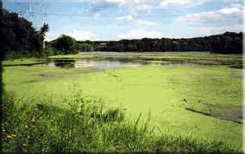
How Nutrients Affect Lakes
A lake that has large amounts of plant growth due to nutrients is known as a eutrophic lake.
Lakes naturally become eutrophic over a long period of time.
However, eutrophication can be accelerated by runoff, such as rain, that can carry sewage, fertilizers, or animal wastes from land into bodies of water.

Slide 11
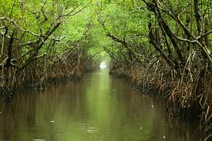
Freshwater Wetlands
Freshwater wetlands are areas of land that are covered with fresh water for part of the year.
The two main types of freshwater wetlands are marshes and swamps.
Marshes contain nonwoody
plants, while swamps are dominated by woody plants.
Most freshwater wetlands are located in the southeastern United States, with the largest in the Florida Everglades.

Slide 12
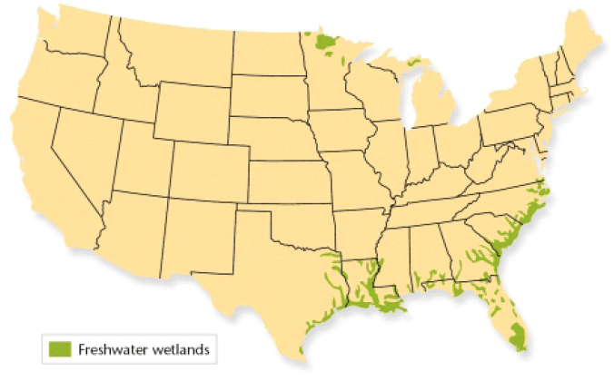
Freshwater Wetlands

Slide 13
Freshwater Wetlands
Wetlands perform several important environmental functions.
Wetlands act like filters or sponges that absorb and remove pollutants from the water.
They also control flooding by absorbing extra water when rivers overflow.
These areas provide a home for native and migratory wildlife in addition to feeding and spawning for many freshwater game fish.

Slide 14
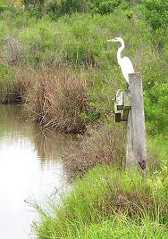
Marshes
Freshwater marshes tend to occur on low, flat lands and have little water movement.
In shallow waters, plants root themselves in the rich bottom sediments while their leaves stick out about the surface of the water year-round.
There are several kinds of marshes, each of which is characterized by its salinity.
Brackish marshes have slightly salty water, while salt marshes contain saltier water.

Slide 15
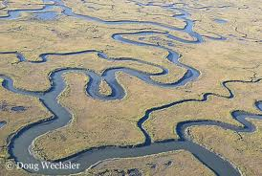
Marshes
The benthic zones of marshes are nutrient rich and contain plants, numerous types of decomposers, and scavengers.
Water fowl, such as ducks, have flat beaks adapted for sifting through the water for fish and insects.
While water birds, such as herons, have spear like beaks they use to grasp small fish and probe for frogs in the mud.
Marshes also attract migratory birds from temperate and tropical habitats.

Slide 16
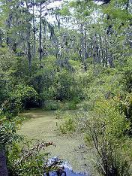
Swamps
Swamps occur on flat, poorly drained land, often near streams and are dominated by woody shrubs or water loving trees.
Freshwater swamps are the ideal habitat for amphibians because of the continuous moisture.
Birds are also attracted to hollow trees near or over the water.
Reptiles are the predators of the swamp, eating almost any organism that crosses their path.

Slide 17
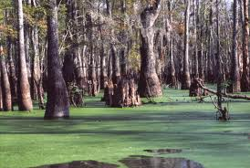
Human Impact on Wetlands
Wetlands were previously considered to be wastelands that provide breeding grounds for insects.
As a result, many have been drained, filled, and cleared for farms or residential and commercial development.
The importance of wetlands is now recognized, as the law and the federal government protect many wetlands while most states now prohibit the destruction of certain wetlands.

Slide 18
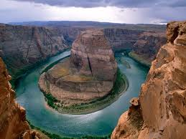
Rivers
At its headwaters, a river is usually cold and full of oxygen and runs swiftly through a shallow riverbed.
As a river flows down a mountain, it may broaden, become warmer, wider, slower, and decrease in oxygen.
A river changes with the land and the climate through which it flows.

Slide 19
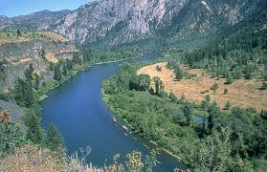
Life in a River
In and near the headwater, mosses anchor themselves to rocks by using root-like structures called rhizoids.
Trout and minnows are adapted to the cold, oxygen rich water.
Farther downstream, plankton can float in the warmer, calmer waters.
Plants here can set roots in the river’s rich sediment, and the plant’s leaves vary in shape according to the strength of the river’s current.
Fish such as catfish and carp also live in these calmer waters.

Slide 20
Rivers in Danger
Industries use river water in manufacturing processes and as receptacles for wastes.
In addition, people have used rivers to dispose of their sewage and garbage.
These practices have polluted rivers with toxins, which have killed river organisms and made river fish inedible.
Today, runoff from the land puts pesticides and other poisons into rivers and coats riverbeds with toxic sediments.

