Slide 1
Evidence of Evolution review

Slide 2
Evidence for Evolution
What do we use in order to determine evolutionary relationships?
Fossil Record
Anatomical Evidence
Molecular Evidence
Embryological Evidence

Slide 3
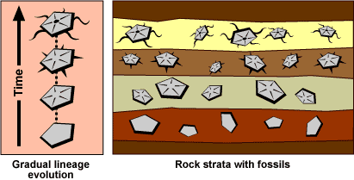
Evidence for Evolution
Fossil Record

Slide 4
Evidence for Evolution
Fossil Record
Scientists study and date fossils in order to draw conclusions about how a species changed over time

Slide 5
Evidence for Evolution
Anatomical Evidence
Scientists compare morphology (anatomical structure) of organisms in order to determine closeness of relationships.
Body evidence!

Slide 6
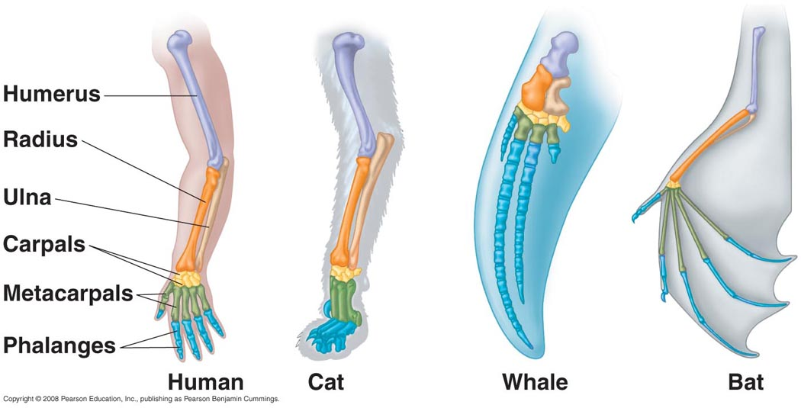
Evidence for Evolution
Anatomical Evidence
Homologous Structures – Same anatomy, different function
Conclude close evolutionary relationships

Slide 7
Evidence for Evolution
Anatomical Evidence
Analogous Structures – Different anatomy, same function
Not closely related, do NOT share a recent common ancestor

Slide 8
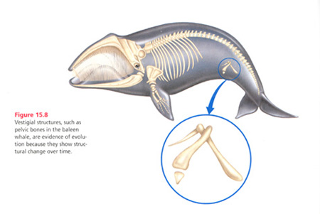
Evidence for Evolution
Anatomical Evidence
Vestigial Structures – No longer serve a purpose
All us to draw conclusions regarding the past

Slide 9
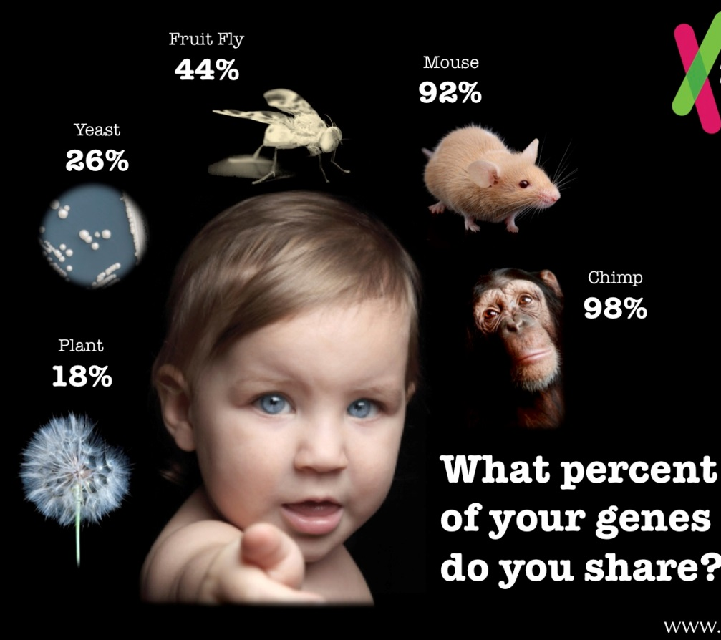
Evidence for Evolution
Molecular/Biochemical Evidence
The more similar the MOLECULES (DNA sequence, proteins, amino acid sequence, etc), the closer the relationship.

Slide 10
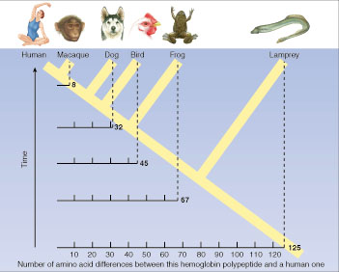
Evidence for Evolution
Molecular/Biochemical Evidence

Slide 11
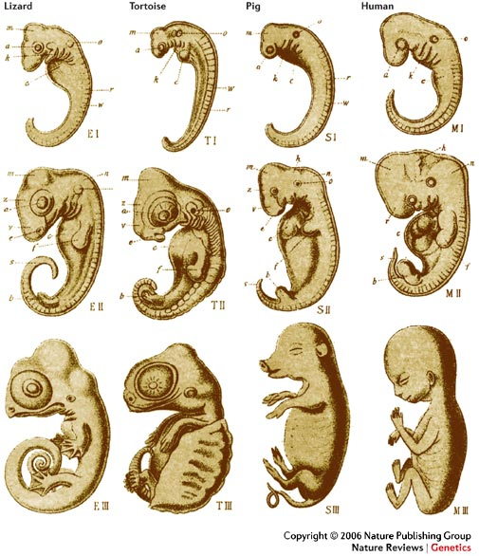
Evidence for Evolution
Embryological Evidence
The more similar the embryo in early development, the closer the relationship.

