Slide 1
Eagle Literacy
March 30th – April 3rd

Slide 2
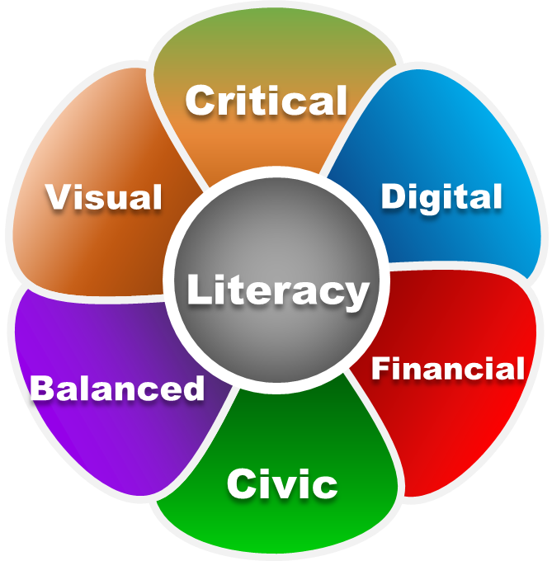
“Digital Literacy”
As we embark on our “new normal”, I wanted students to continue with our literacy novel,
The Sun is Also a Star.
Students can read at different paces so I have created general literacy questions for the chapters.
You can choose how students respond to those discussion questions. Examples may include:
You can have your students read each day or all of the pages for the week. It’s up to you!
Students submit their answers on your blog or discussion forum.
You can have a video conference once a week with your 3rd period to discuss the questions and novel.
Choose which questions you feel would best benefit your 3rd period students.
Remember this is our “new normal” so we can adjust to whatever works best for you and your students.

Slide 3
“Chapters for the Week”
PDF page numbers
Monday – pgs. 183 - 187
Tuesday – pgs. 188 - 193
Wednesday – pgs. 194 - 197
Thursday – pgs. 198 - 201

Slide 4
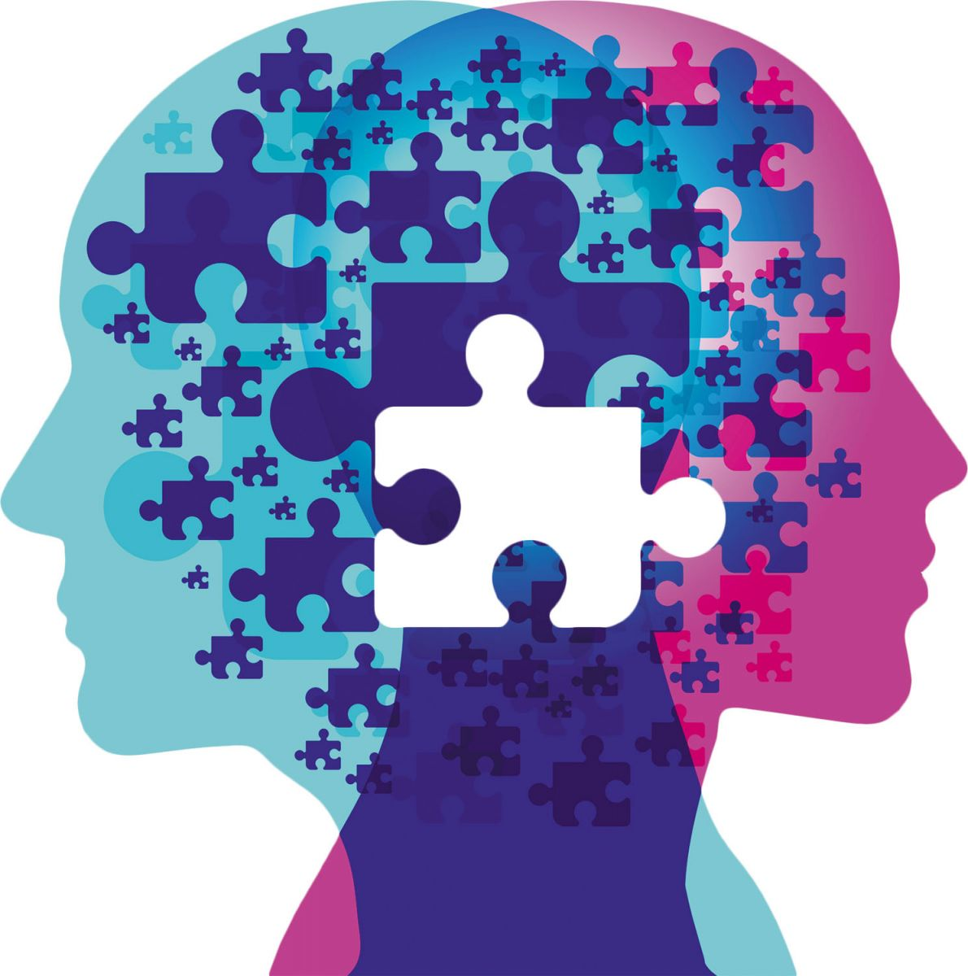
Novel Questions
*Remember questions are written generically so students can answer regardless of where they are in the novel.
What challenges does immigration bring the characters? What difficult decisions must they face to pursue their dreams?
How does learning about the character’s past help you understand their present?
How does obtaining the American Dream reveal itself as a central theme? Do our characters believe they can achieve it?
Can love overcome any obstacle? Do our characters see love as a way to beat the odds despite what they see stacked against them?
What do you predict will happen next?
Monday - Thursday
Notes:
■ stressor (an activity, event, or thing that adds stress)
■ trauma (a deeply distressing or disturbing experience)
■ intergenerational trauma (when untreated trauma gets passed down by parents to their children)
■ race-based trauma (when the experience of a racial encounter impacts someone mentally and emotionally)
■ civil disobedience (the refusal to comply with certain laws or to pay taxes and fines as a peaceful form of political protest)
Discuss how the terms relate to various historical events to reinforce the differences.
■ Slavery, Imperialism/Colonialism: Stressor
■ The Los Angeles Riots after the police beating of Rodney King in 1992: Trauma
■ The Jews who experienced the Holocaust: Intergenerational Trauma
■ The violent colonization and assimilation of Native Americans: Race-based Trauma
■ Martin Luther King’s “Letter from Birmingham Jail” and his other forms of protests: Civil Disobedience

